Slide 1
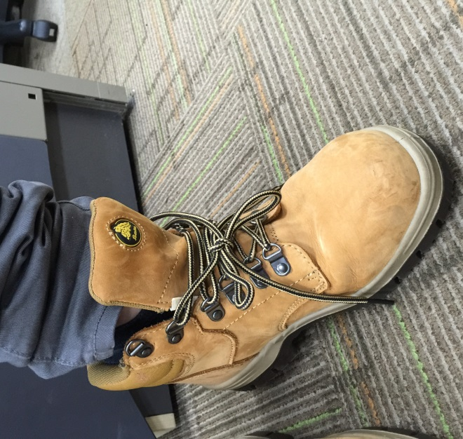
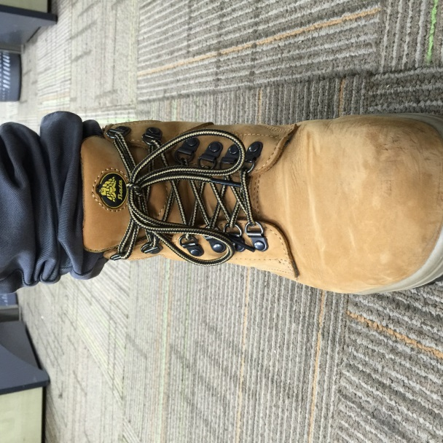
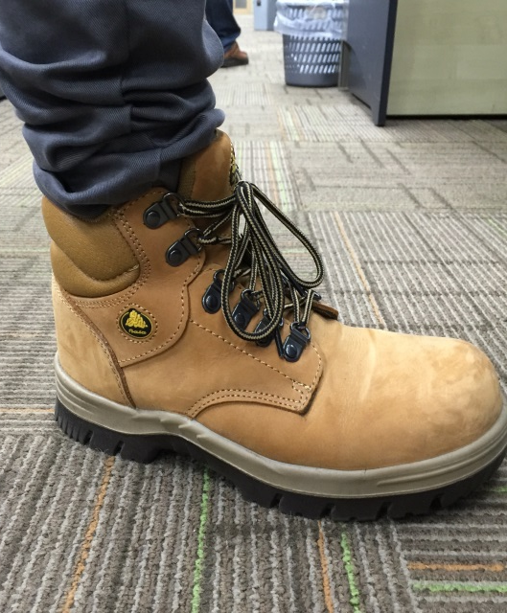
Safety Tips When Wearing Safety Shoes
√
DO’S
Wear socks
Safety shoes should fit snugly around the heel and ankle when laced.
Lace up your safety shoes fully
Regularly inspect for damage
Repair or replace any worn out or damaged safety shoes
Regularly trim your toe nails
X
√
X
X
DON’TS
Loose shoe lace
Safety shoes not fully laced up
√
√

Slide 2
穿着安全鞋的安全提示
√
正确事项
穿袜子
当绑紧鞋带后，安全鞋应该包紧脚跟和脚踝
完全绑好你的安全鞋
定期检查是否有损坏
修理或更换任何磨损或损坏的安全鞋
定期修剪你的脚趾甲
X
√
X
X
错误事项
松的鞋带
安全鞋未完全绑好
√
√

