Slide 1




Water Efficiency Management System and Measures
Facilities BIC Team
Singapore Submarine 577

Slide 2


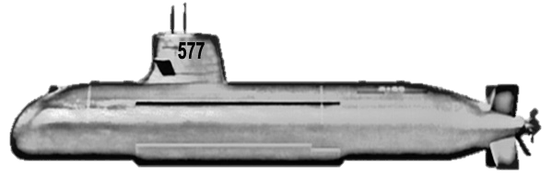

Team Members
Team Name:
Singapore Submarine 577
Project Leader: Yang Haixiang
Members: Kow Mui Hiang
Rowena Villamayor
Loo Tee Hui
A Retnam Murualikaran
Vivian Ma Yan
Project Advisor: Tang Wai Meng

Slide 3
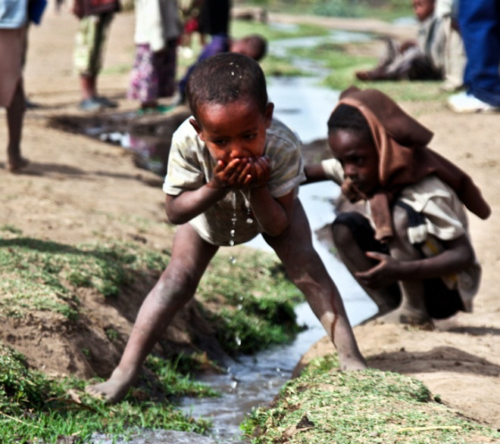
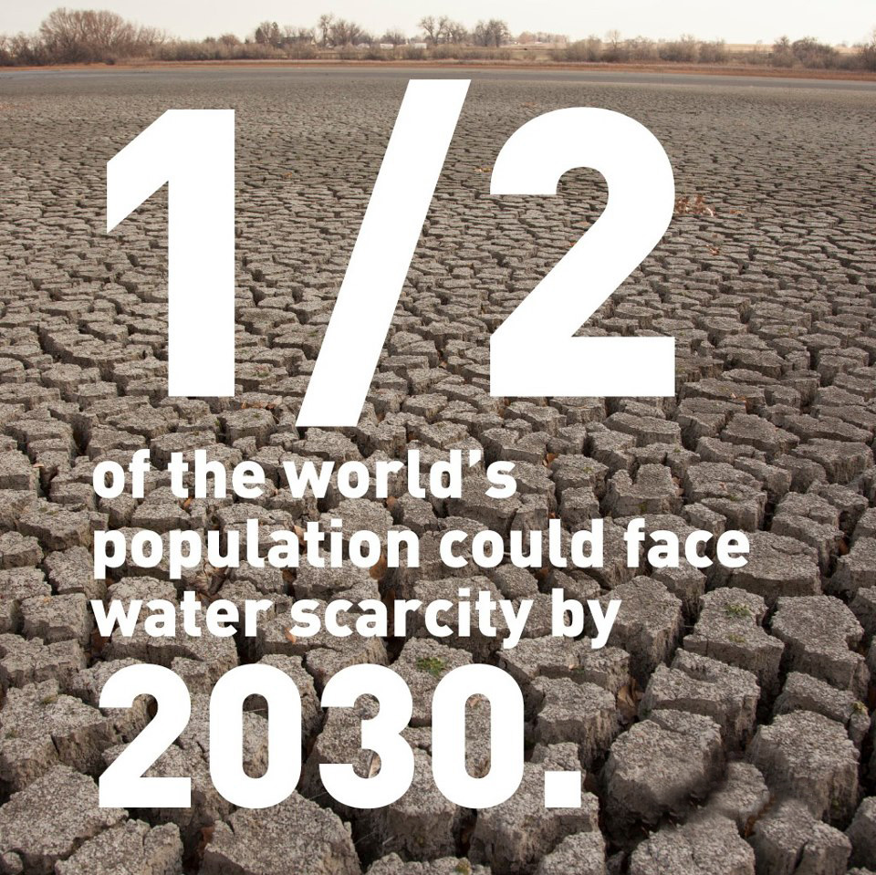

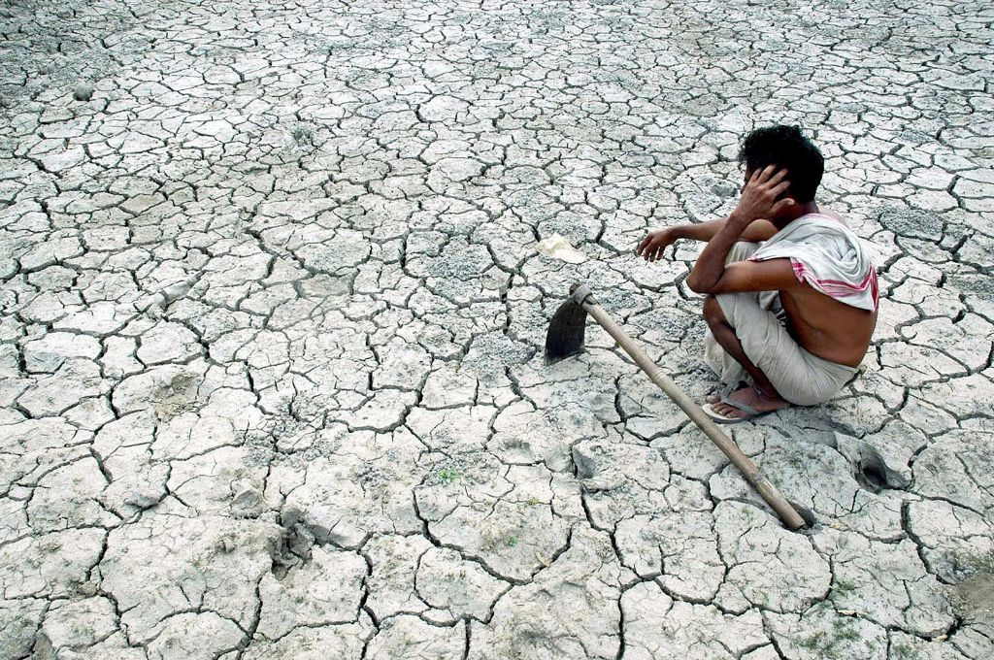
Philips has a strong social responsibility in maintaining our environment…..

Slide 4

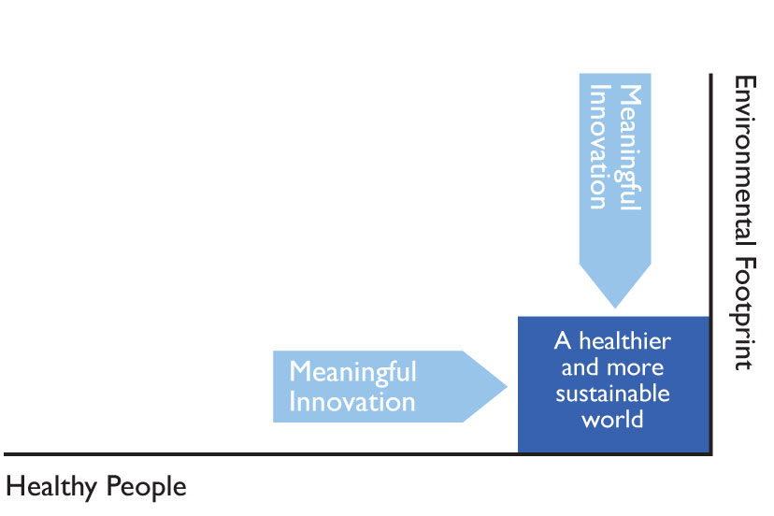
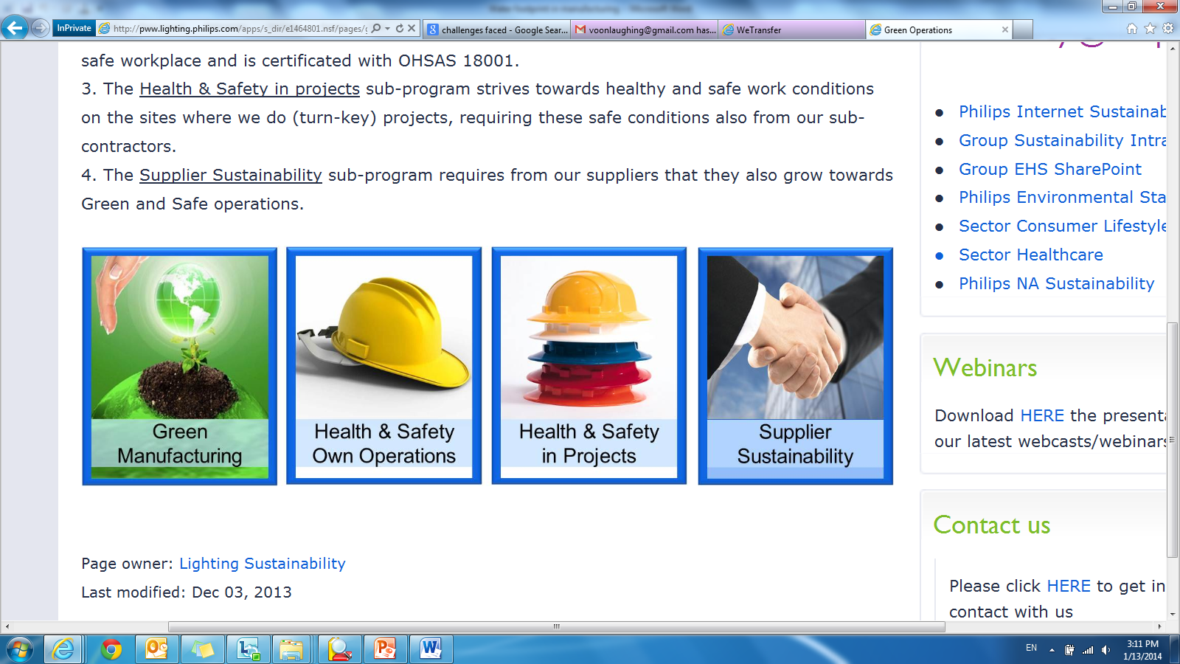
D
C
D
I
Project Problem Definition
M
A
Philips Sustainability Vision and Water Footprint
Vision
At Philips we strive to make the world healthier and more sustainable through Innovation.

Slide 5

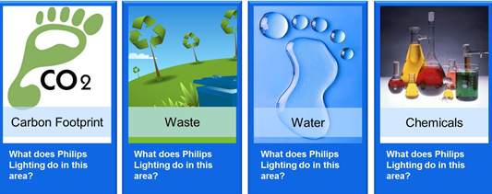
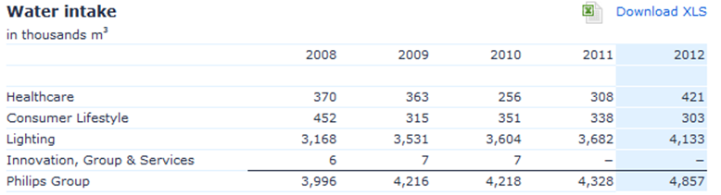

D
C
D
I
Project Problem Definition
M
A
Philips Sustainability Vision and Water Footprint
Lighting is 85% of total water usage of Philips Group.
Lumileds represents 37% of total water consumption of Lighting sector.
Singapore is the major consumer and located in a water scarcity region.

Slide 6

D
C
D
I
Project Problem Definition
M
A
Water Efficiency Index
Year | BAI (000,000) | Water use 000m³/year | Water Efficiency Index
2011 | 801 | 606 | 0.76
2012 | 1,076 | 711 | 0.66
2013 | 1,277 | 880 | 0.69
Water Efficiency Index
+22%
+17%
Increased Newater tariff from PUB contributes to higher operational cost too

Slide 7

D
C
D
I
Project Problem Definition - Objectives
M
A
To reduce wastage
To meet environmental responsibility
To improve Water Efficiency Index by 20% by 2013 & reduce water cost $1M annually

Slide 8

D
MA
C
M
I
Measurement & Analysis
A
Type of PUB Water Used
Production Tools
Cooling Tower
Process Cooling Water
DI Water
Scrubber

Slide 9

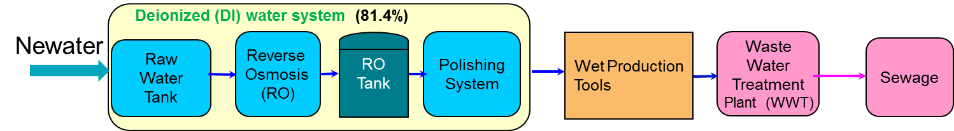
D
C
A
I
Analysis
M
A
Cause & Effect Analysis-Newater
Water leakage at production floor
Low efficiency DI system
High Newater Consumption in DI System & Production
No waste water reclaim

Slide 10
D
C
A
I
Analysis
M
A
Cause & Effect Analysis-Potable Water
Leakage at water fixtures
High flow rate at water tap
High Water Consumption at Wash Rooms & Cafeteria
Lack of communication/
feedback channel
Cafeteria staff lack awareness

Slide 11
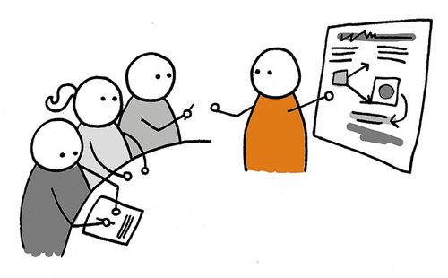
D
C
A
I
Analysis
M
A
Philips Behaviors:
- Eager to win
- Take ownership
- Team up to excel
Causes:
Water leakage at production floor
Low efficiency DI system
No waste water reclaim
Leakage at water fixtures
High flow rate at water tap
Lack of communication/
feedback channel
Cafeteria staff lack awareness
Solutions:
Tap on PUB fund
Partnering with vendor on waste water reclaim
System efficiency improvement
Install leak detection system
Improve awareness
Proper consumption tracking
Brainstorm
The Lumileds Attitude
- Make never before
possible, possible.
- What can I do better?
- Accept responsibility
and take bold action.
- Have fun

Slide 12



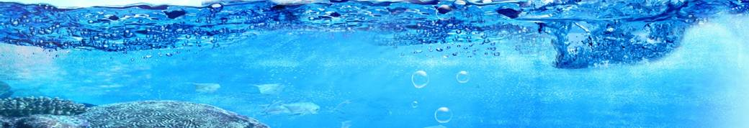
D
C
I
I
Project Implementation -1 of 6
M
A
Concept of Waste Water Reclaim System
RO Reject Water from DI System
Thinning Process Waste Water
Air Handling Units’ Condensate
Waste Water Reclaim is 28,000m3 water per month, this is equivalent to 11 Olympics swimming pools.
RO grade water

Slide 13
D
C
I
I
Project Implementation -1 of 6
M
A
Waste Water Reclaim System Implementation
NeWater
Cooling Tower
Deionized (DI) water system
Scrubber
Process Cooling Water
Production Tools
Raw Water Tank
Reverse
Osmoses
(RO)
RO Tank
Polishing System
Wet Tools
Waste
Water
Treatment
Plant (WWT)
Sewage
Waste Water Reclaim System
RO Reject
Wafer Thinning Tools
Air Handling Unit (AHU) condensate
Waste Water Reclaim Skid
Product Water
Reject Water

Slide 14
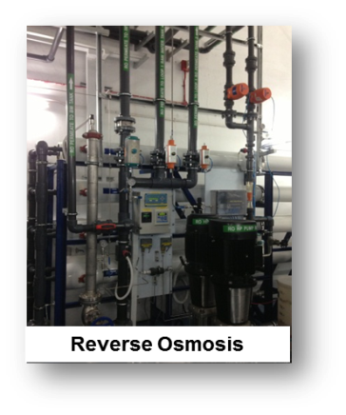
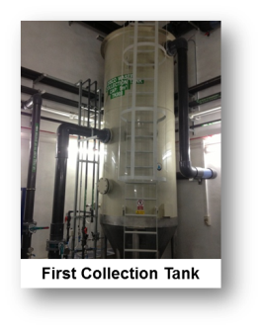
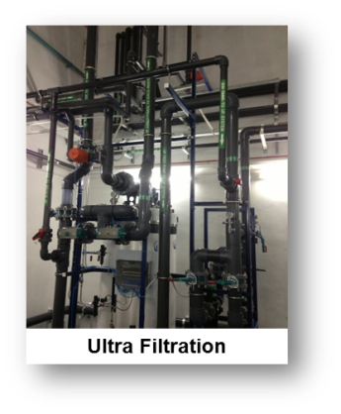
D
C
I
I
Project Implementation -1 of 6
M
A
Waste Water Reclaim System Schematic (WWRS)
Wafer Thinning Tools
RO Reject from DI plants
AHU Condensate
Reject Water
Cooling Tower
FT
WWT
FT
Product Water
UF Transfer
pump
Existing
RO Tank in DI Plant
Central Collection
Tank
WWT
De-sludge
pump
UF Back wash
pump
RO Transfer
pump

Slide 15


D
C
I
I
Project Implementation -1 of 6
M
A
Product Water Quality of WWRS
Parameter | Unit | Design Data | Actual Result
Conductivity | Us/cm | <15 | <5
Total Organic Carbon (TOC) | ppb | <50 | <15
pH value |  | 7 - 8 | 7 - 8
The product water is RO water grade and will be directly top up to existing RO water tank of the DI system.
Return on Investment
This system enabled Lumileds Singapore to recycle 43% of water consumed.
11 months with funding from PUB

Slide 16

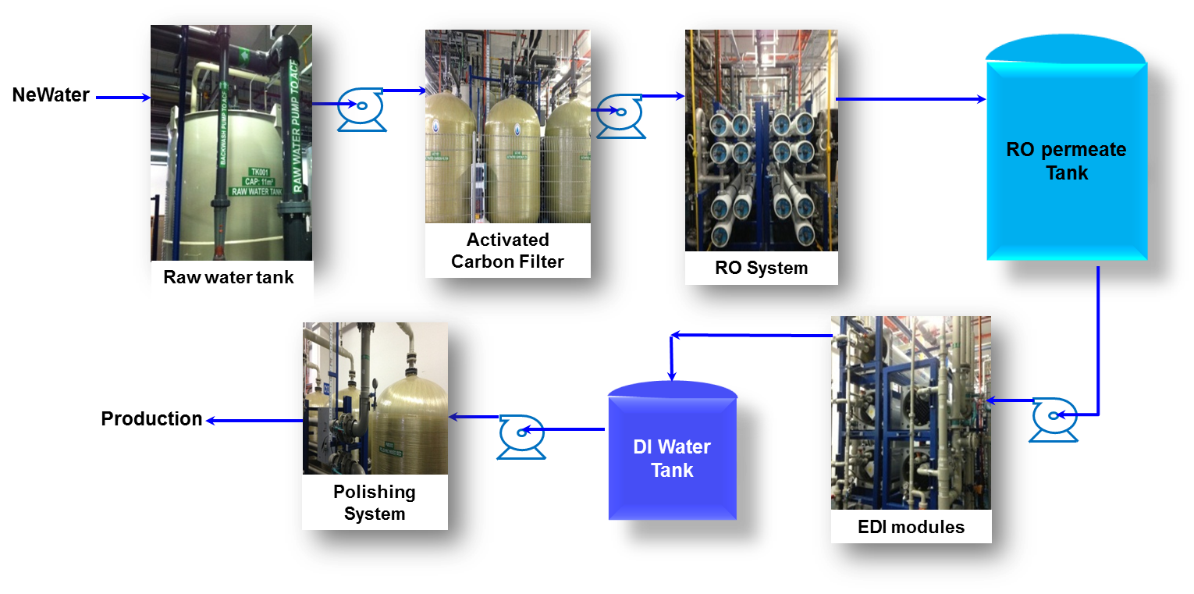

D
C
I
I
Project Implementation -2 of 6
M
A
De-ionized Water Systems’ Upgrading
DI Water Loop 1 Schematic Drawing
Water Recovery Rate Around 86%
72%
86%
72%
Inefficient
DI Water System
Highly Efficient
DI Water System

Slide 17
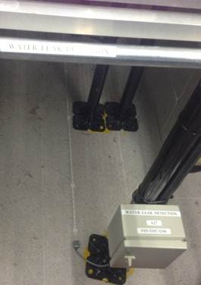
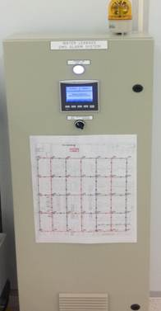
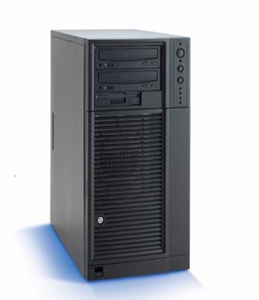
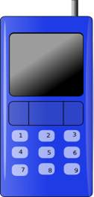
D
C
I
I
Project Implementation -3 of 6
M
A
Installation of Water Leak Detection System
Water leak detection sensor
Centre Control Panel
Monitor through
Building Management System
Alarm via SMS
Installed sophisticated Water Leak Detection System at Wafer Fab & Saber Clean Rooms to detect any water leaks.

Slide 18
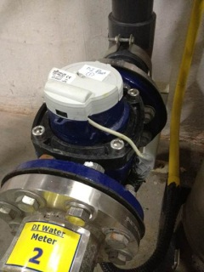
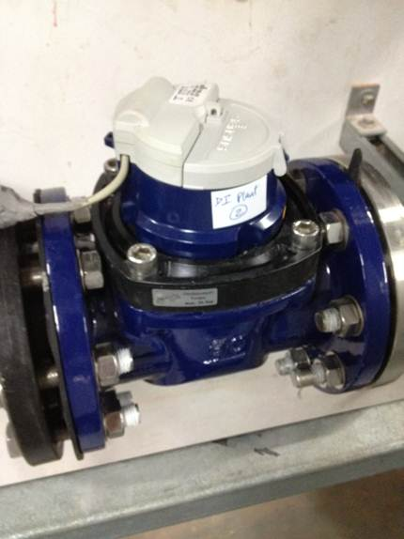
D
C
I
I
Project Implementation -4 of 6
M
A
Installation of Smart Water Meters
Worked with PUB to install 8 nos. of Smart Water Meters at:
1. Cafeteria
2. Cooling Towers
3. Production tools
4. DI system Loop 1
5. DI system Loop D
6. Production building toilets
7. Annex building toilets
8. Waste Water Reclaim System
1. The meters take readings at
intervals of 15 minutes
automatically.
2. The data are transferred to
Building Management System.
1. The data enable us to
understand current
consumption trends.
2. To formulate future plans.
The objective is to help us to formulate future plans to conserve more water
We started the project in Dec 2012 and completed in Apr 2013.
Smart Water Meters
Smart Water Meters

Slide 19

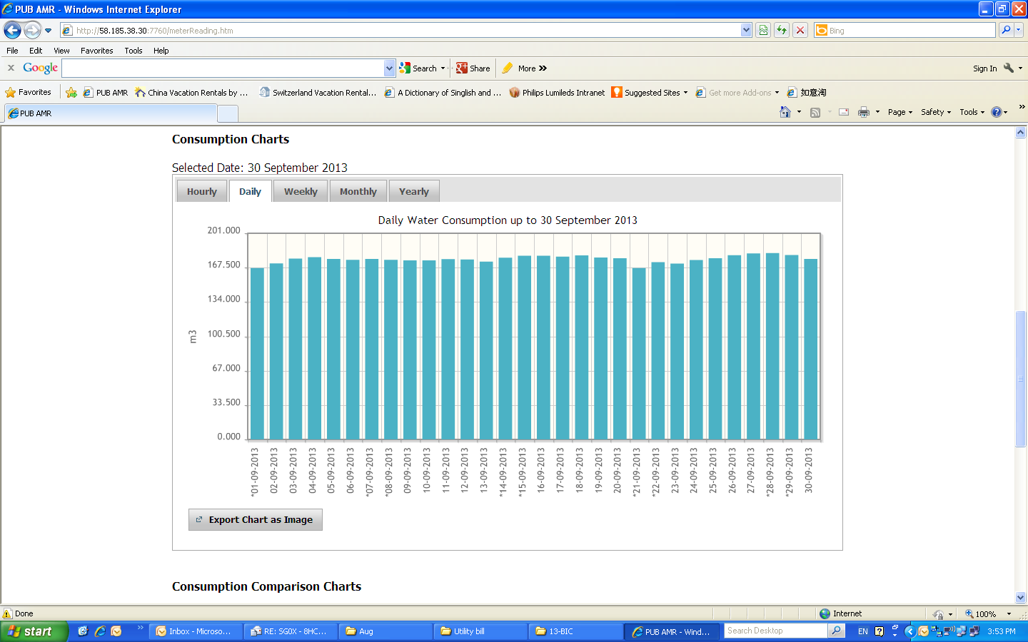
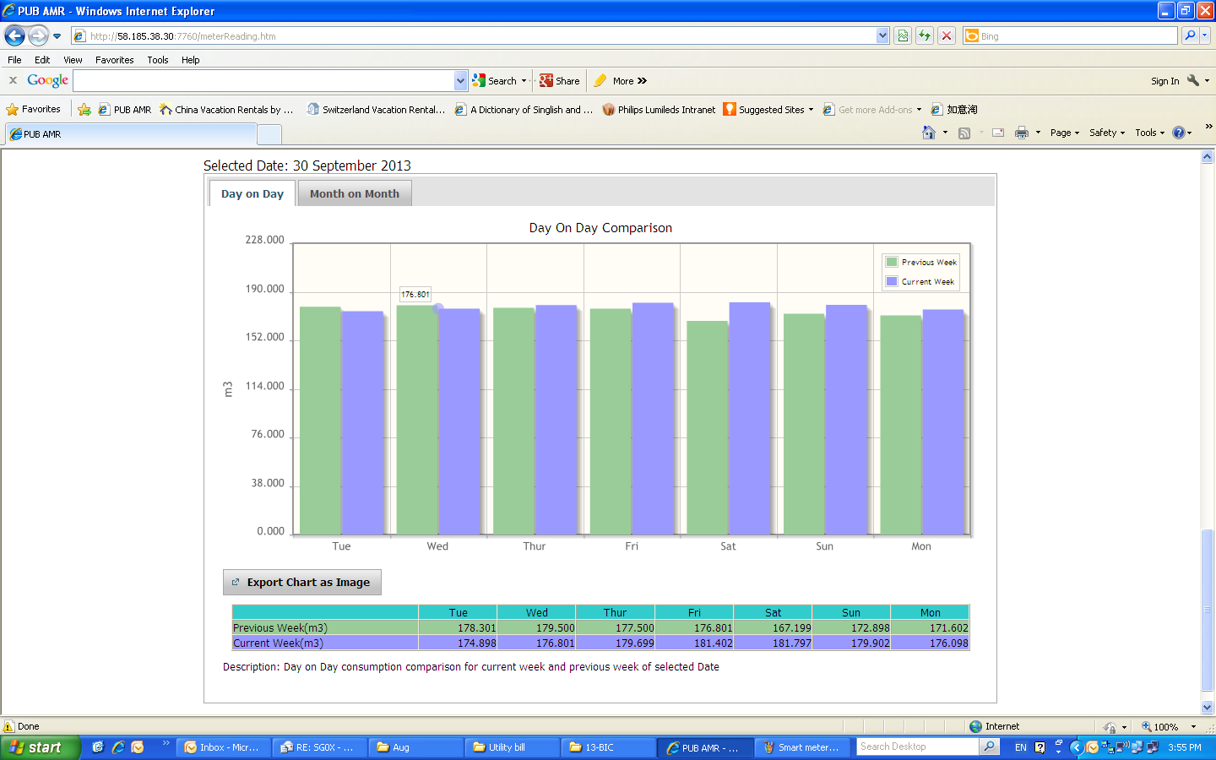
D
C
I
I
Project Implementation -4 of 6
M
A
Water Consumption Charts from PUB Web Portal

Slide 20

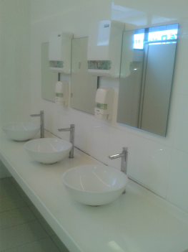
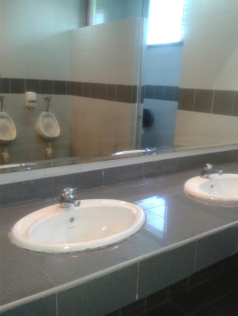
D
C
I
I
Project Implementation -5 of 6
M
A
Potable Water Conservation in Washroom and Cafeteria
Educate cafeteria staff about water conservation at cafeteria
Repair any faulty water fixtures
Reduce water tap flow from 20.0 to 8.0 L/min for Cafeteria and 8.0 to 2.0 L/min for Washroom (follow Government Guideline)
Perform monthly audit and gathering feedback
Washroom tap change to self closing type

Slide 21
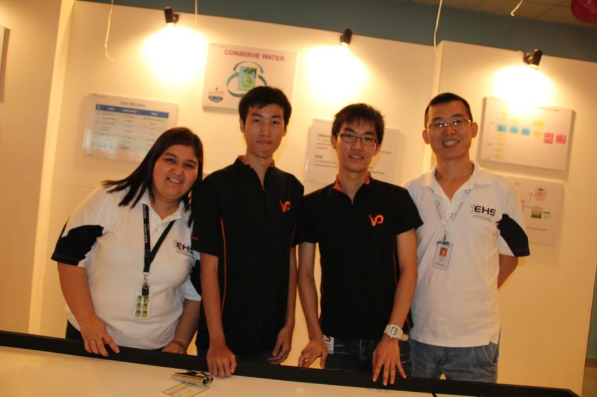
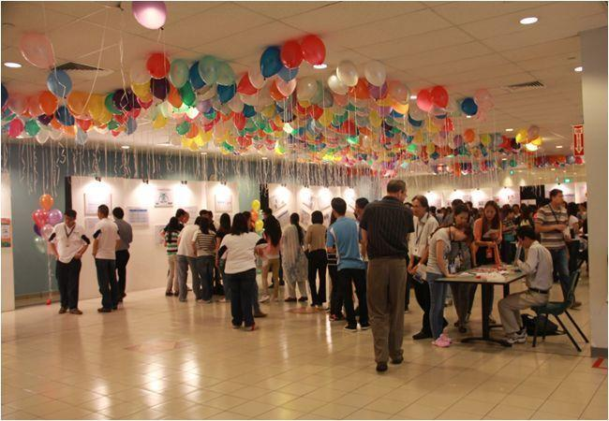

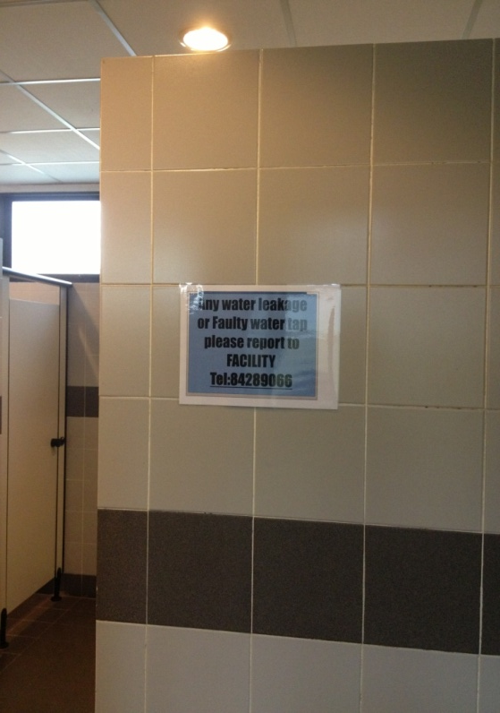
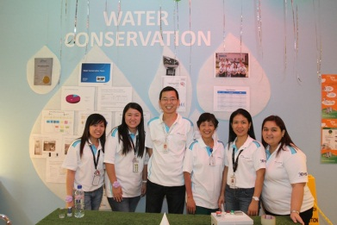
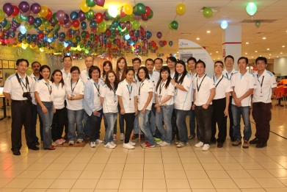
D
C
I
I
Project Implementation - 6 of 6
M
A
Communication of Water Conservation Program
2012
Training
2013
Annual EHS Carnival
Feedback
We encourage feedback on Water Conservation.
Efforts help to enhance the awareness of water conservation & environmental sustainability.

Slide 22
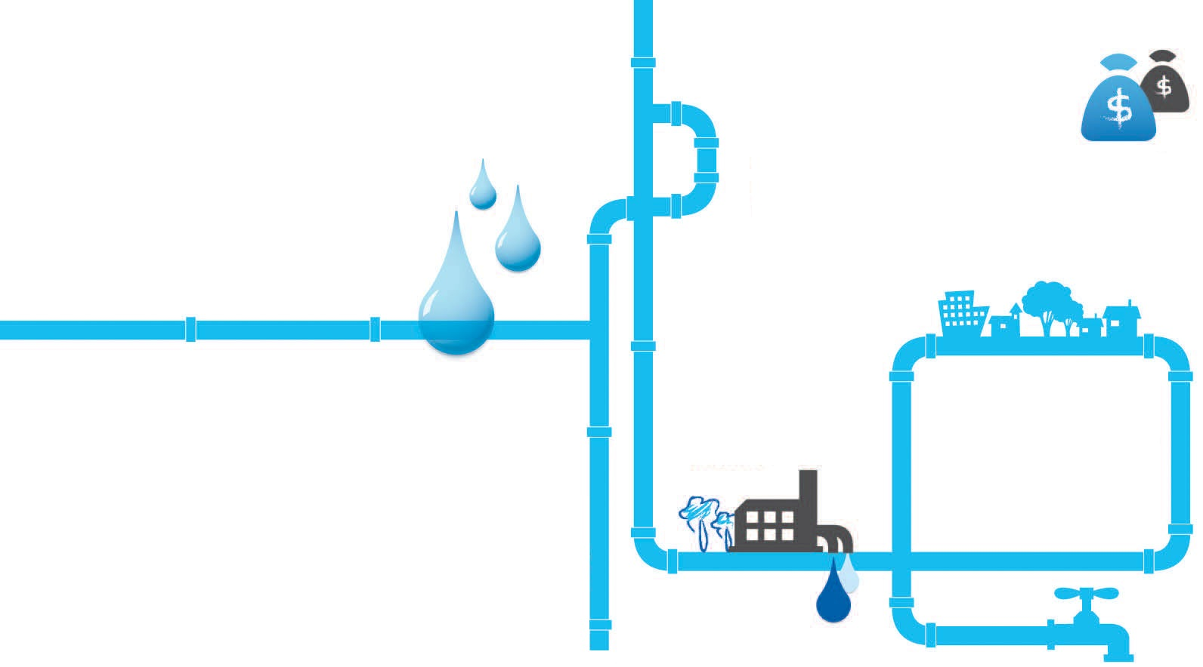


D
C
I
I
Project Implementation - Summary
M
A
De-ionized Water Systems’ Upgrading
Waste Water Reclaim System
Reclaimed 43% of Total Used Newater
86% Water Recovery Rate
Installation of Smart Water Meters
Water Leak Detection System
Water Conservation Communication
Potable Water Conservation in Wash Rooms and Cafeteria

Slide 23

D
C
I
I
Project Implementation - Challenges Faced
M
A
Other Challenges:
1. Get understood by employees in
wash room water conservation.
2. Gain ownership from Cafeteria staff.
3. Difficult to get production windows time.
Technical Challenges:
1. Chemistry for ultra-filtration system.
2. Best technology with Return on Investment
of less 1 year.
3. Complex drain lines.
4. Control the waste water spec
5. Tough process of obtaining the
governmental funding of S$243,000.
6. Inconsistent water pressure from PUB
supply.
7. Low temperature of waste water
cause component failure.

Slide 24

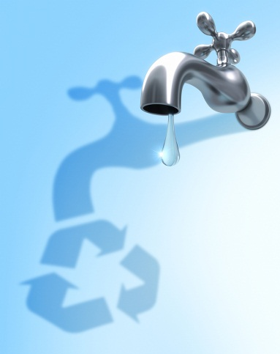
D
C
I
I
Project Achievements-Financial Benefits
M
A
Water Efficiency Index
Water use in the preceding years and future needs
Year | BAI (000,000) | Water use 000 m³/year | Water efficiency index
2011 | 801 | 606 | 0.76
2012 | 1,076 | 711 | 0.66
2013 | 1,083 | 511 | 0.47
Total aving per year SGD1.2M and Improved WEI by 29%

Slide 25


D
C
Project Control and Sustainability
C
I
M
A
Established Water Efficiency Management System
Setup Feedback and Knowledge Sharing Channel
Facilities Webportal to manage and monitor facilities operation programs
Water Efficiency Policy in Dual language

Slide 26
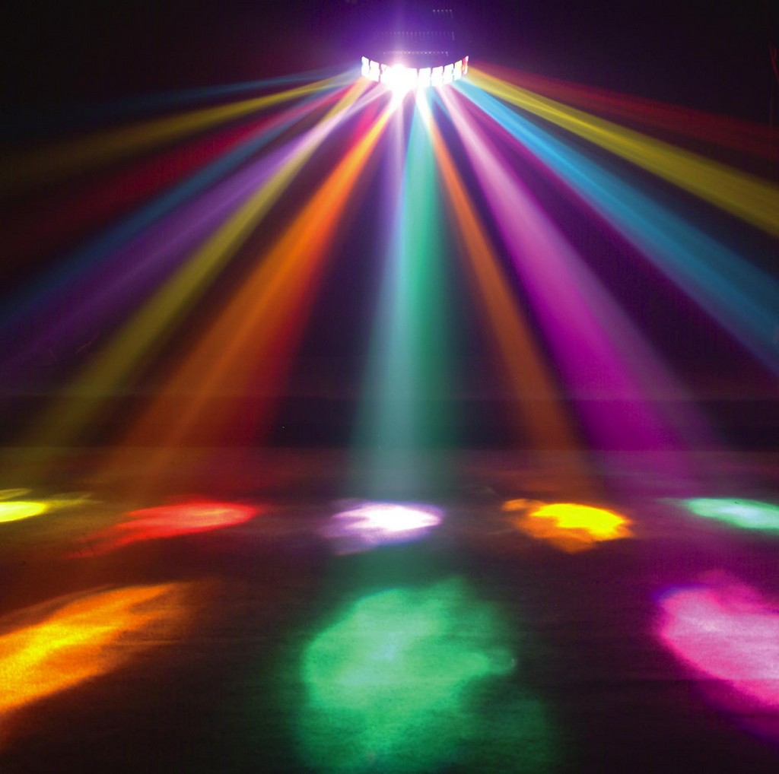
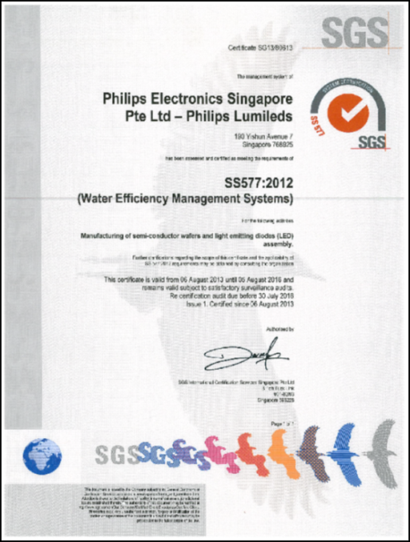
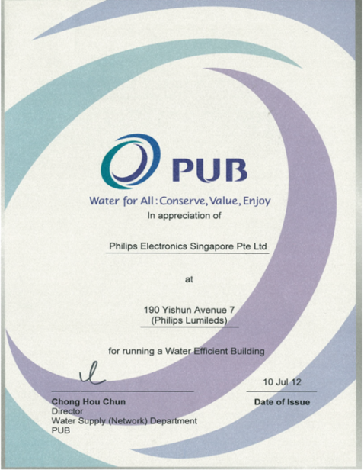
Project Achievements
Awarded Water Efficient Building Certification (Basic) in Jul 2012.
Philips Lumileds was certified for the National Standard SS577:2012 – Water Efficiency Management System on 31 July 2013.

Slide 27
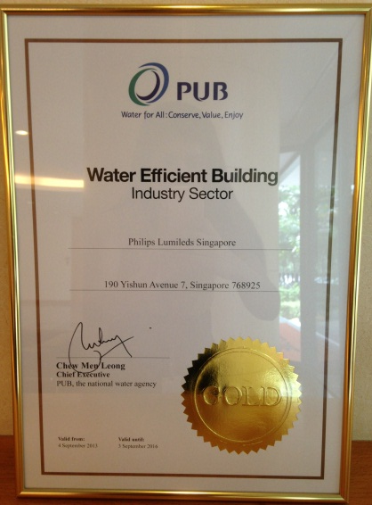
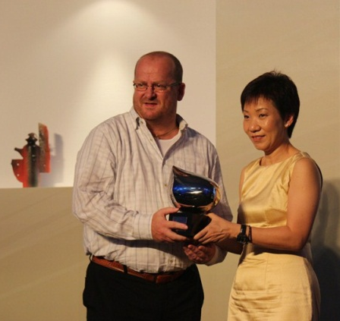
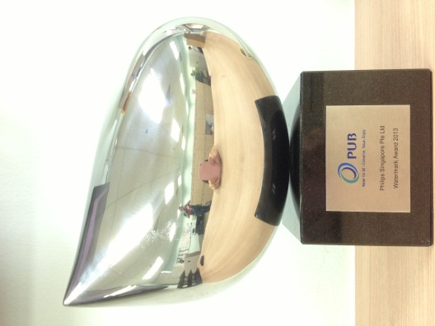
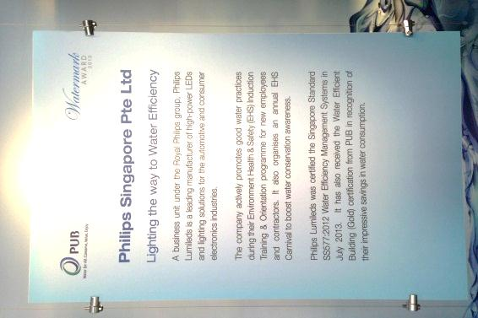
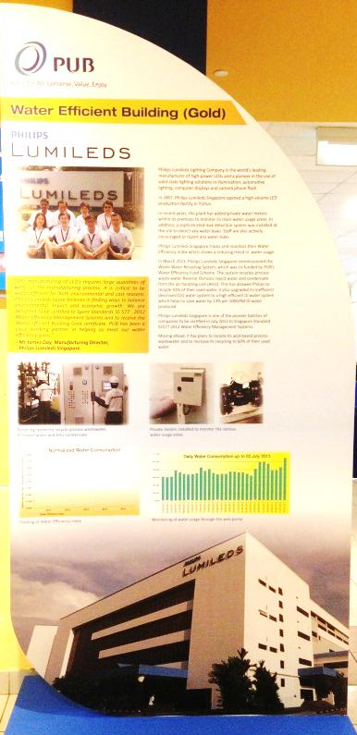
Project Achievements
In Sep 2013
Received Watermark Award from Minister Grace Fu
Received Water Efficient Building Certification (Gold)

Slide 28
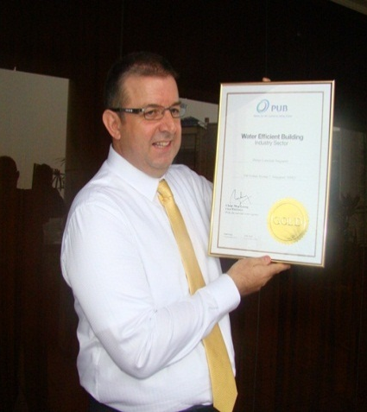
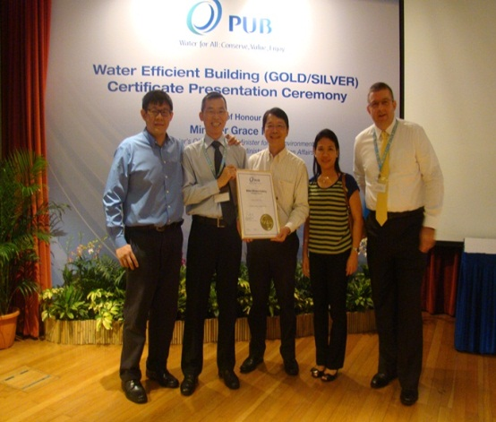
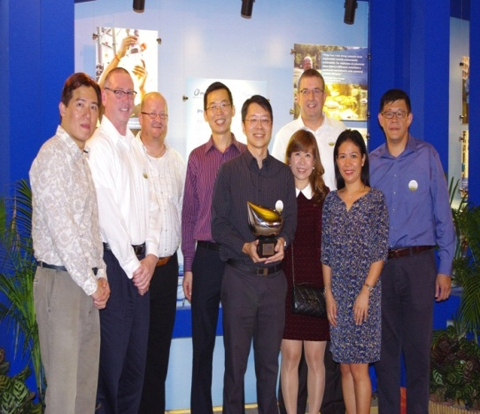
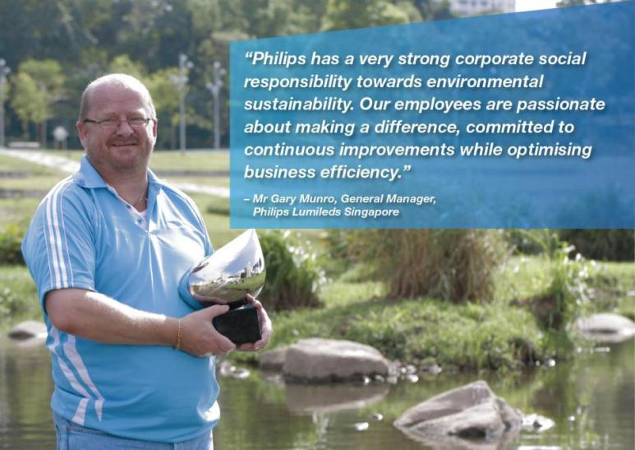

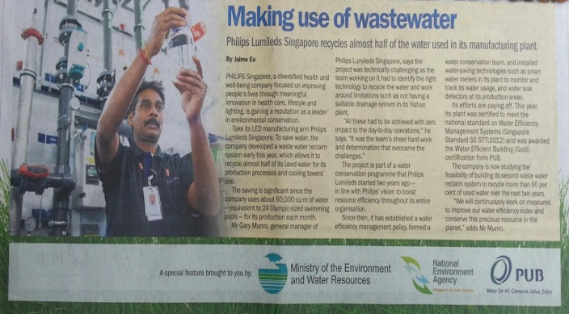
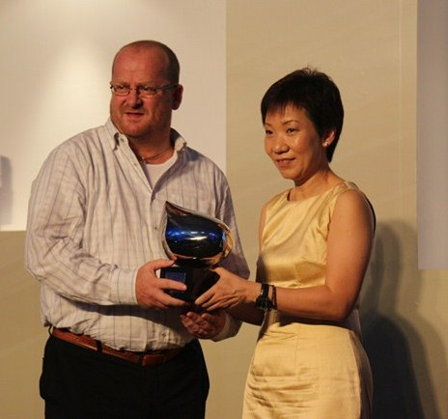
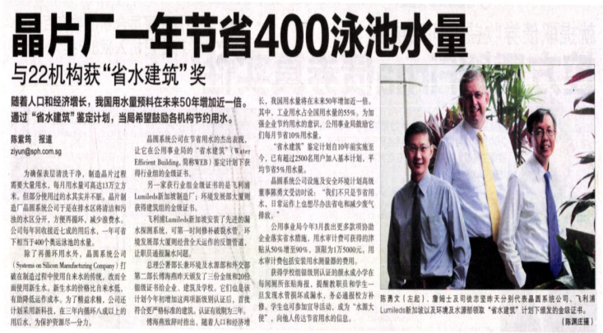

Project Achievements
Reported by Various Medias
The Straits Times, Channel New Asia, Singapore Lianhe Zao Bao newspapers, TV Channels and Radio Station
Watermark and
Water Efficiency Building
Gold Award 2013

Slide 29









Project Learning
Project Sharing
Gained valuable technical
knowledge on waste water recycling.
Established excellent working
rapport with PUB.
“Never before possible, possible!”
  Dream big
  Great teamwork
  Just do it
Public launch of new standard SS577
Water Efficiency Building Gold
Award ceremony
Watermark Award ceremony
Town hall meeting, employee
training, EHS Carnival & display
posters.
Our story was publicized in various
media.
Eager to Win
Accelerated all action defined, executed with full speed and improved WEI by 29%.
Take Ownership
Team accomplished and excelled expected results.
Team up to Excel
Used diversified expertise to drive fast results.

Slide 30



Far-reaching Environment Sustainability
Philips has a very strong social responsibility.
Our team is committed to continuously
exploring solutions in water conservation
to balance economy and ecology.
We reduced water consumption and
operates in environmentally and socially
responsible manner.

Slide 31

Our Future Plan…
To further improve WEI by another 15% in next two years
Continue find ways to conserve water
Build second Waste Water Reclaim System
Outreach to society for environmental sustainability

Slide 32
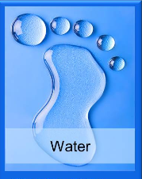

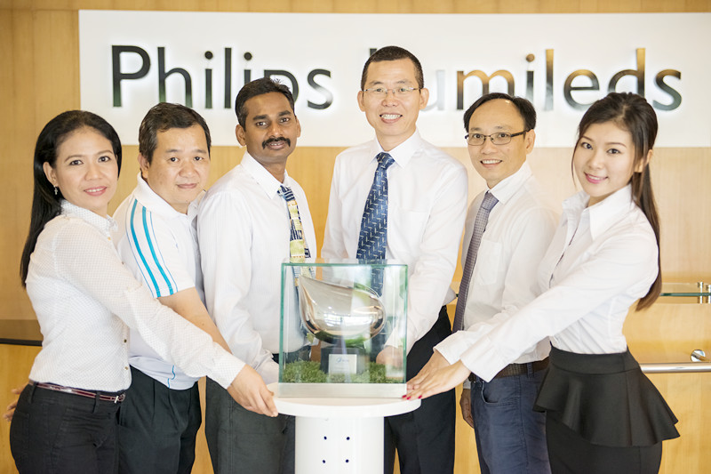
Save Water save our planet
Singapore Submarine 577
Save Water save our planet
Start with me
Never before possible, possible!

