Slide 1
LUMILEDS SINGAORE
FACILITIES OVERVIEW
RAJA JAWAHAR
AUGUST 2016

Slide 2
CONTENT PAGE
LUMILEDS SINGAPORE SITE INFORMATION
LUMILEDS SINGAPORE FACILITIES TEAM INTRODUCTION
LUMILEDS SINGAPORE FACILITIES SYSTEM OVERVIEW

Slide 3
LUMILEDS SINGAPORE
SITE INFORMATION

Slide 4
LUMILEDS SINGAPORE FAC INTRODUCTION
LUMILEDS SITE INFORMATION
Main Building
4 Level Building, Cleanroom at Level 2, 3 & 4
Floor Area – 35,767 m2
Cleanroom
10,000 m2 (Class 1000/100)
Wafer Capacity
3200 Wafers/Week
Site Area
34,223 m2
ANNEX Building
2 Level Building housing Cafeteria, Offices, Training Rooms
Floor Area – 5,945 m2

Slide 5
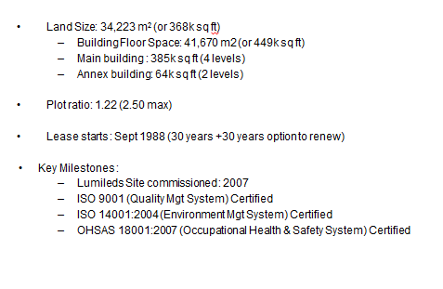
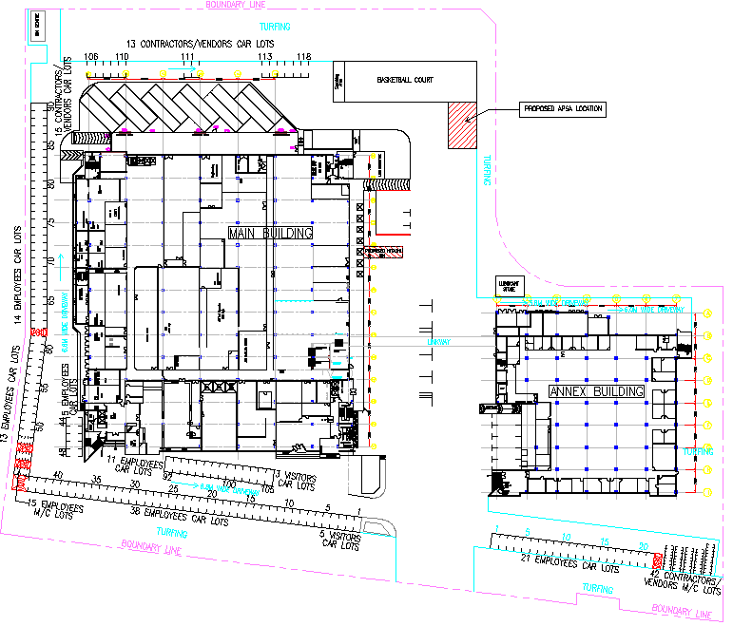
35,767m²
5,945m²
Main
Building
Link-way
Fire Evacuation Assembly point
ANNEX
Building

Slide 6
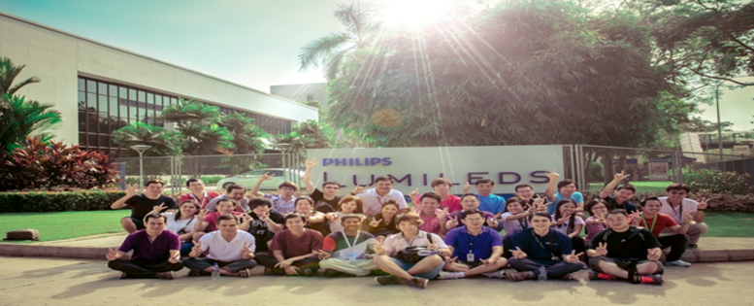
LUMILEDS SINGAPORE
FACILITIES TEAM INTRODUCTION

Slide 7
LUMILEDS SINGAPORE FAC
INTRODUCTION
Build and Operate sustainable World Class Facilities that enable excellence in Safety, Reliability and Cost.
Support manufacturing of LEDs by providing safe & reliable infrastructure, services and uninterrupted supply of utilities, conform to required specifications and compliance to regulatory/industry standards.
The utilities/infrastructure comprises of :
Power Supply - Waste Collection facilities
ACMV (Air Conditioning & Mechanical Ventilation) - Chilled Water System
DI Water - Process Cooling Water
Scrubber/Exhaust System - Compressed Dry Air
Chemical and Gas - Fire Protection Systems
Process Vacuum - Life Safety System
Waste Water Neutralization Plant - Building Services
Domestic Water

Slide 8
LUMILEDS SINGAPORE FAC INTRODUCTION
LUMILEDS SNGAPORE FACILITIES TEAM ORGANISATION CHART
SINGAPORE ENGINEERING
KEVIN URAM
SNR.DIRECTOR
FACILITIES HOD
RAJA JAWAHAR
DIRECTOR
OPERATIONS & MAINTENANCE & BUILDING SERVICES
FACILITIES ENGINEERING
PROJECT & TOOL INSTALL
ENVIRONMENTAL & HEALTH SAFETY
WONG CHEE KEAT
SNR MANAGER
ANAN
MANAGER
RAHMAN
MANAGER
ROWENA
MANAGER

Slide 9
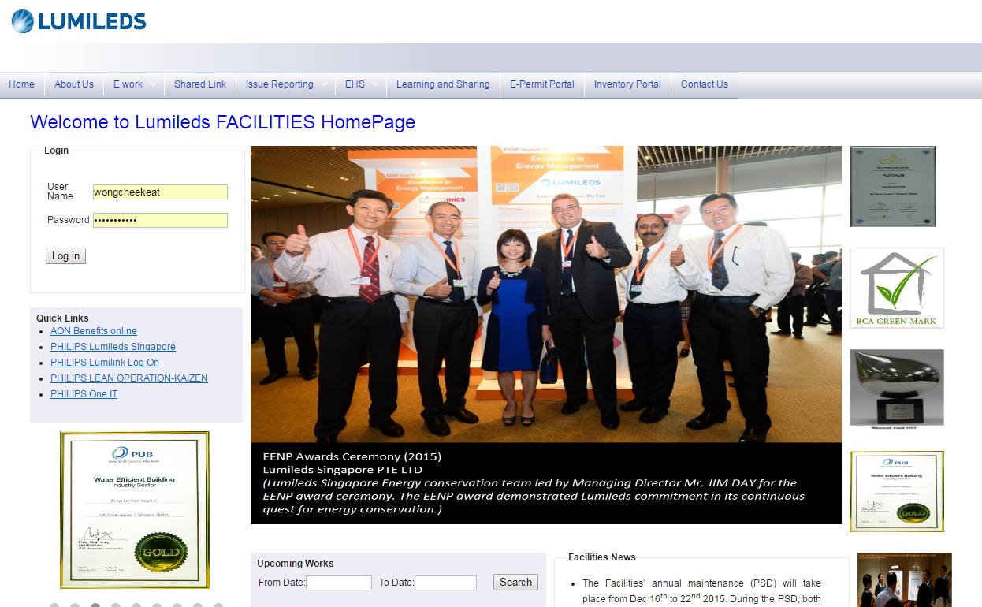
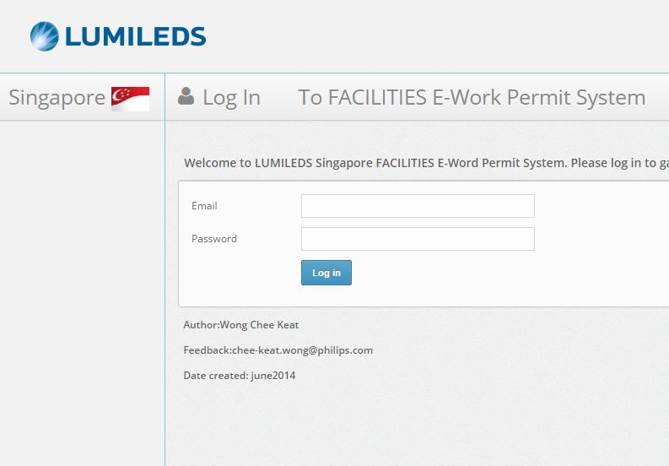
LUMILEDS SINGAPORE FAC INTRODUCTION
FACILITIES WORK SYSTEM
FACILITIIES WEBPORTAL
GENERAL WORK REQUEST
ISSUE REPORTING
PREVENTIVE MAINTENANCE PORTAL
E-WORK PERMIT SYSTEM
CHEM AND GAS INVENTORY PORTAL
EHS CHEMICAL APPROVAL
FACILITIES CHANGE MANAGEMENT

Slide 10
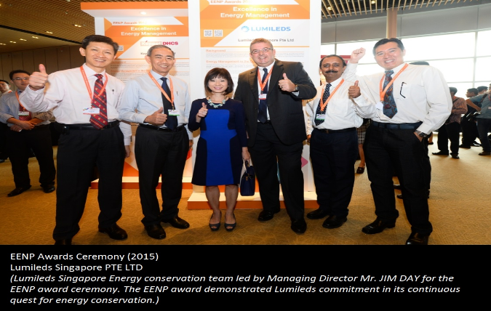
LUMILEDS SINGAPORE FAC INTRODUCTION
FACILITIES ACHIEVEMENTS

Slide 11
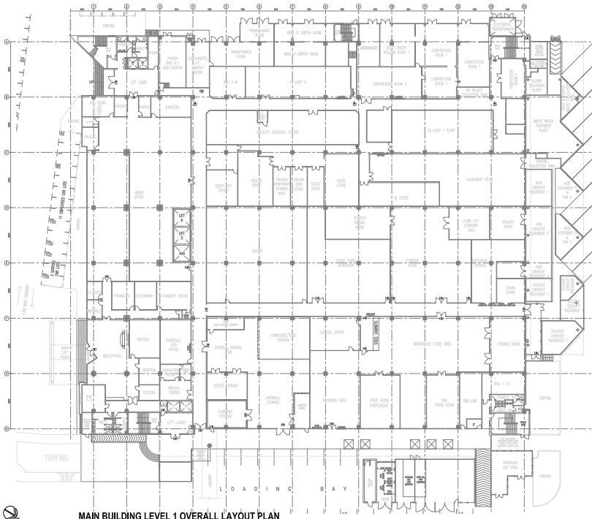
LUMILEDS SINGAPORE
FACILITIES SYSTEM OVERVIEW

Slide 12
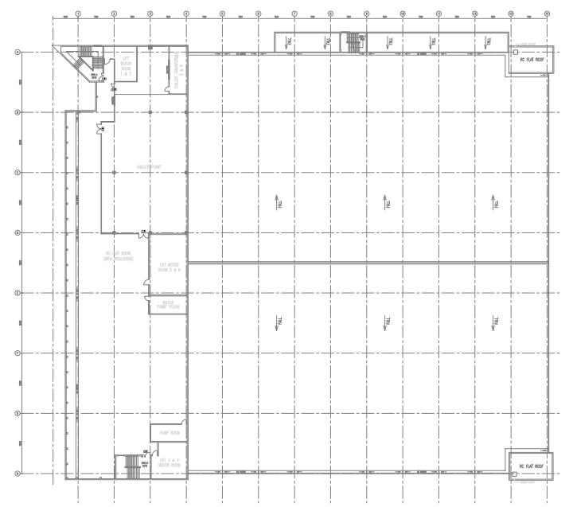
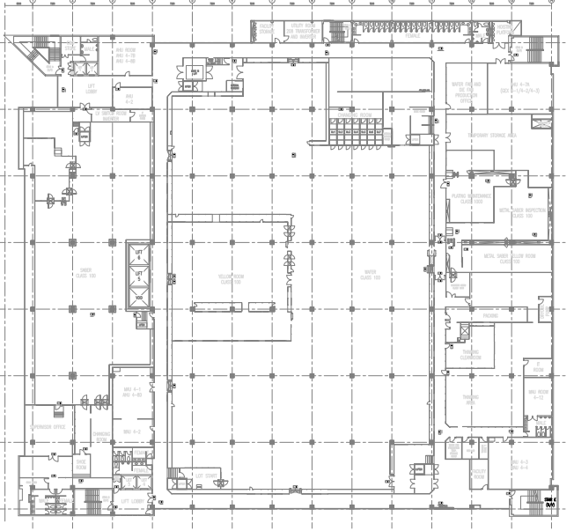
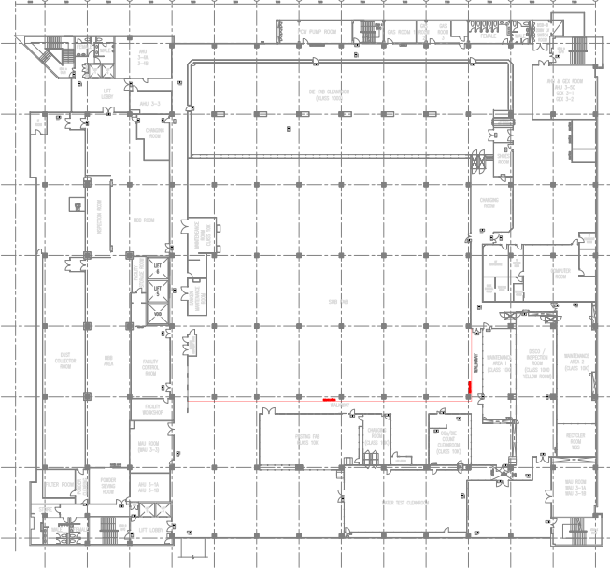
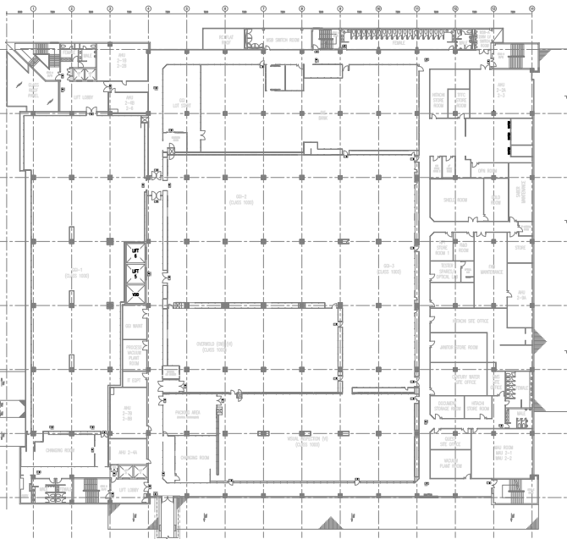
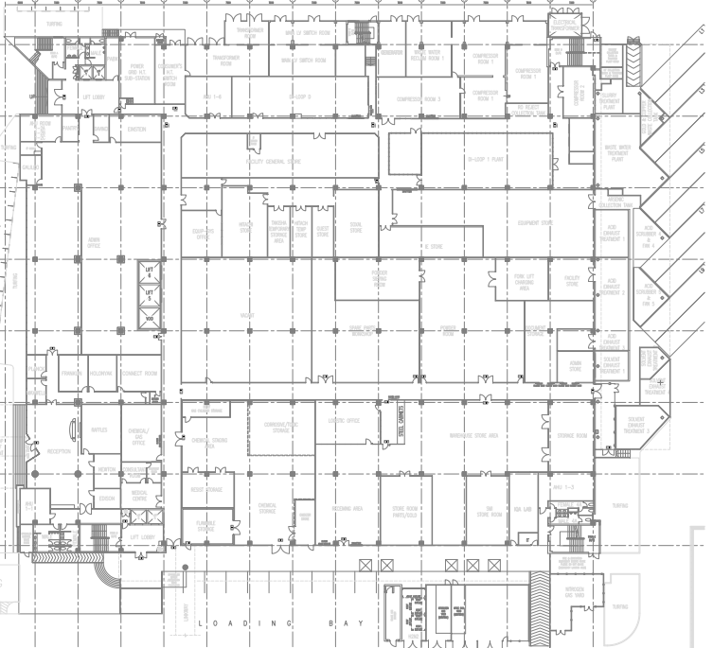
MAIN BUILDING
Roof Top
Level 4
Level 3
Level 2
Level 1
Level 1 – Compressor Room; DI Water Plant; Waste Water Treatment Plant; Chemical and Gas store;
Chemical and Gas Control Room; AHU MAU Room; Flammable Gas room; Bulk Gas Yard;
N2 Generator; Scrubber Yard
Level 2 – Vacuum pump room; AHU/MAU Room
Level 3 – FAC Control Room; Sub FAB; Gas room; PCW#1; AHU/MAU Room; GEX Room
Level 4 – MAU/AHU Room
Roof Top – Chiller Room; Cooling Tower; PCW#2 Room

Slide 13
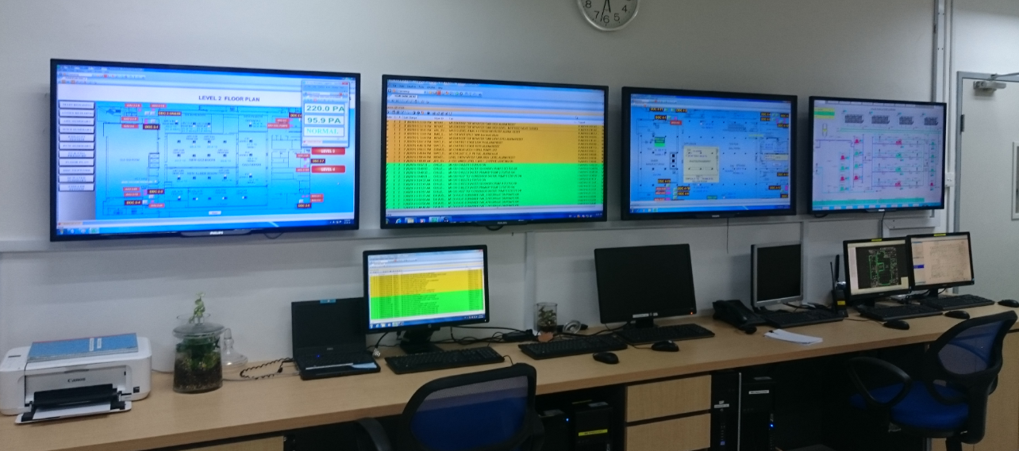
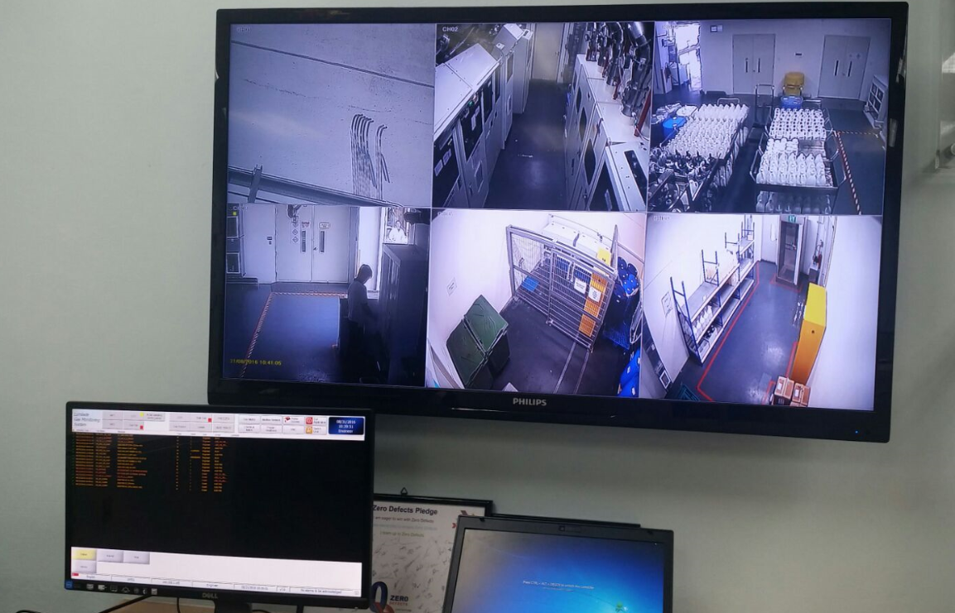
FACILITIES SYSTEM OVERVIEW
FACILITIES MONITORING AND CONTROL SYSTEM
Facilities Control Room @ Main building level 3
FMCS – Operations Team:
Operated 24X7 throughout the year
12hrs Compressed shift
4 Shift operations (D1, N1, D2, N2)
3 Technicians per shift (2 AE and 1 Control Rm Tech)
6 chem.Tech (Day; 3 technicians; 3 Chem.Store)
3 Chem.Tech (Night)
FMCS – BUILDING AUTOMATION SYS (BAS):
Monitors & Controls the below systems:
HVAC & Mechanical systems
Electrical systems
Waste Water Treatment Plant
Office area AHU, FCU
Life Safety system
Chemical and Gas distribution system
CHEM & GAS Control Room @ Main building level 1

Slide 14
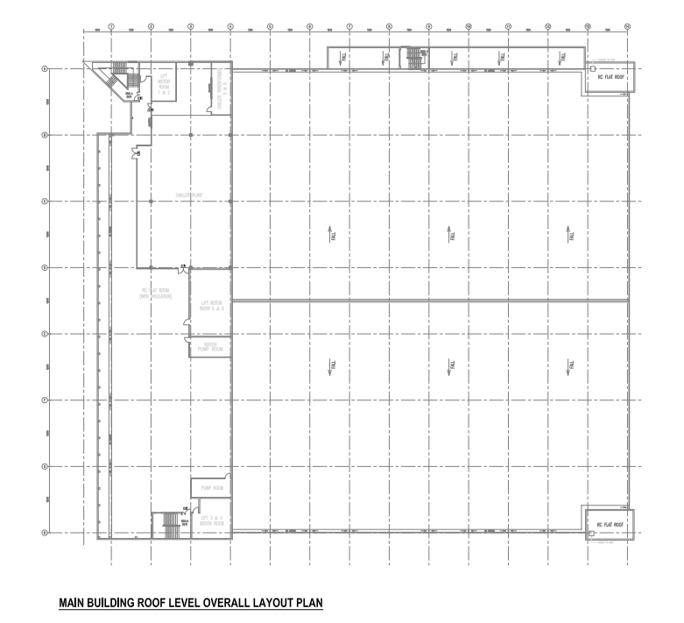
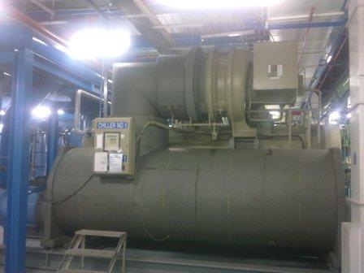
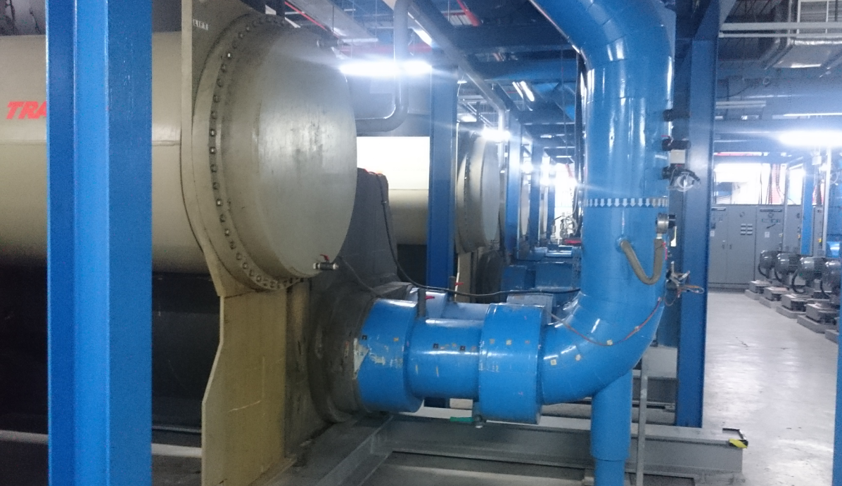
FACILITIES SYSTEM OVERVIEW
Chilled Water System
Chilled Water System
Main Building Rooftop
System Capacity 3300 RT
Major Components:
Utilization: 66%
4 Trane Centrifugal chiller 1100 RT each
Primary chiller water pump
4 Centrifugal pump 600 m3/hr(37kw) each
Secondary chiller water pump
4 Centrifugal pump 600 m3/hr(112kw) each

Slide 15
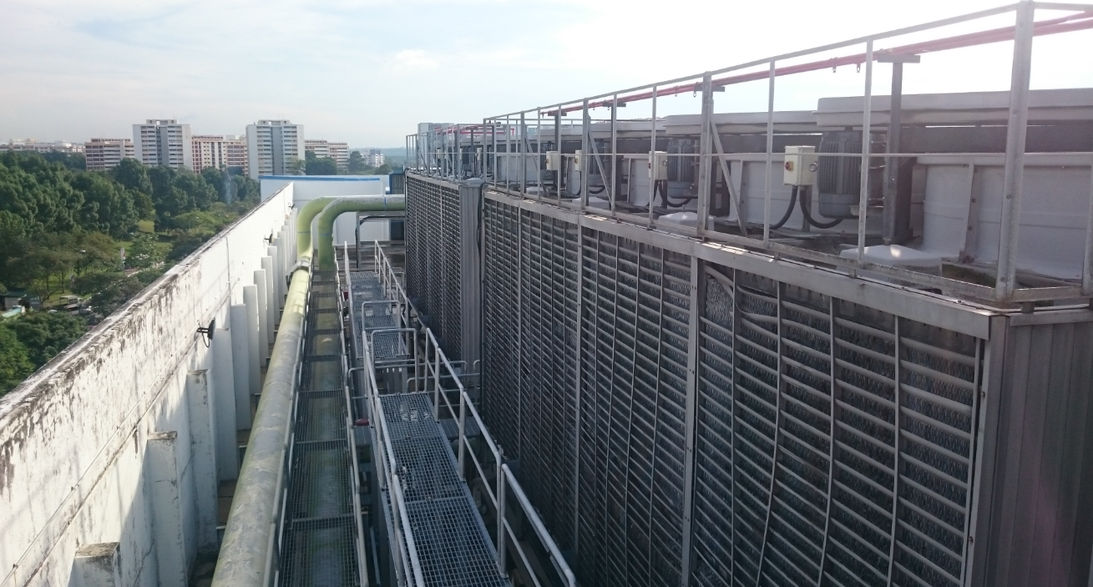
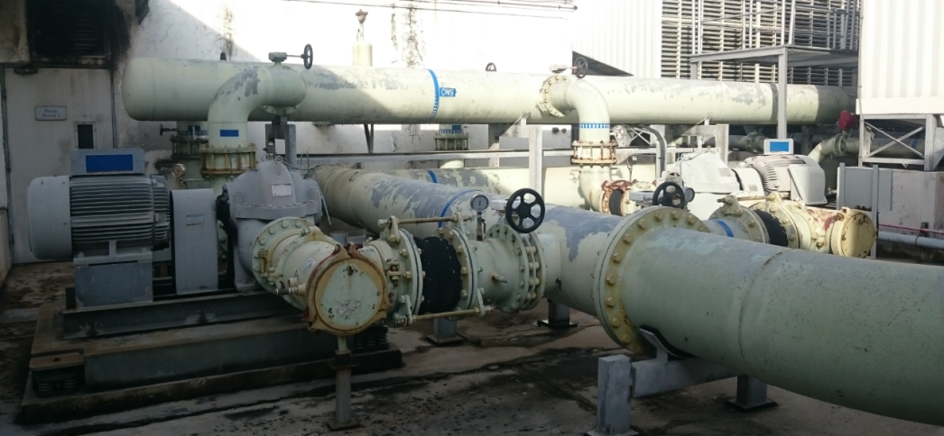
FACILITIES SYSTEM OVERVIEW
CONDENSER WATER SYSTEM AND COOLING TOWER
Cooling tower main building rooftop
Main Building Rooftop
System Capacity 4300RT
Major Components:
Utilization: 66%
4 Cooling Towers: 2 x 1500RT; 2 x 1400RT (design ∆T = 5.6 ᵒc)
4 Centrifugal pumps (condenser water) 1380m3/hr each

Slide 16
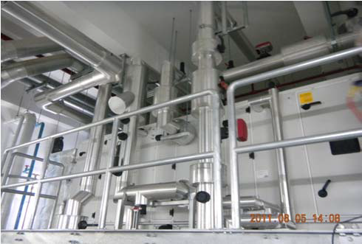
FACILITIES SYSTEM OVERVIEW
MAKE UP AIR UNIT & AIR HANDLING UNIT
Make Up Air Unit
System Capacity
Major Components:
Utilization 100%
55nos of Make-Up Air / Air Handler Units:
Main Building Level 4 FAB MAU/AHU 500,000m³/hr
Main Building Level 3 MAU/AHU 221,500m³/hr
Main Building Level 2 MAU/AHU 494,000m³/hr
Main Building Level 1 MAU/AHU 207,000m³/hr
Supply air Spec to FAB: 21ºC +/- 2; RH 55%+/- 5%
Supply air spec to WF Yellow room: 21ºC +/- 1; RH 45%+/- 5%

Slide 17
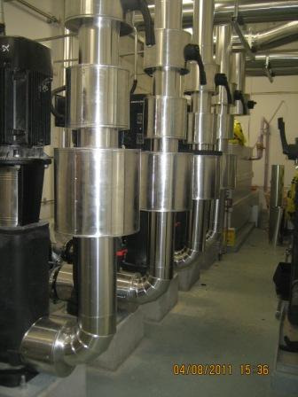
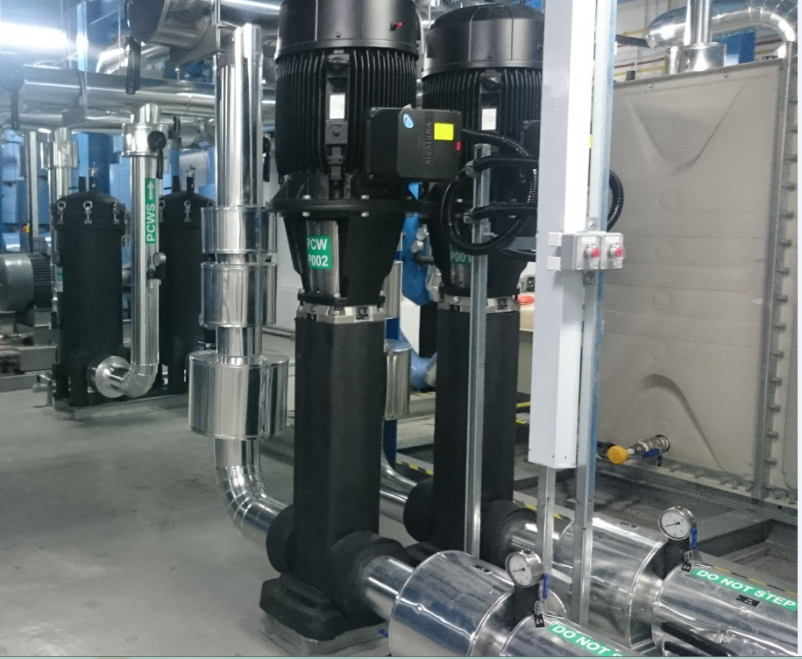
FACILITIES SYSTEM OVERVIEW
PROCESS COOLING WATER SYSTEM
PCW # 1 located at main building level 3
PCW # 2 located at main building rooftop
System Capacity 240m³/hr
Utilisation:60%
Major Components:
PCW # 2
1 Heat Exchanger
2 Filter Units (50 micron) 115 m³/hr each
2 Centrifugal Pumps 120 m³/hr each
1 Storage tank
System pressure: ∆P 3.5 Bar; Temperature 17ºC
System Capacity 180m³/hr
Utilization: 75%
Major Components:
PCW # 1
2 Heat Exchangers 179 m³/hr each
5 Filter Units (50 micron) 45 m³/hr each
1 Storage tank
System pressure: ∆P 4 Bar; Temperature 17 ºC

Slide 18
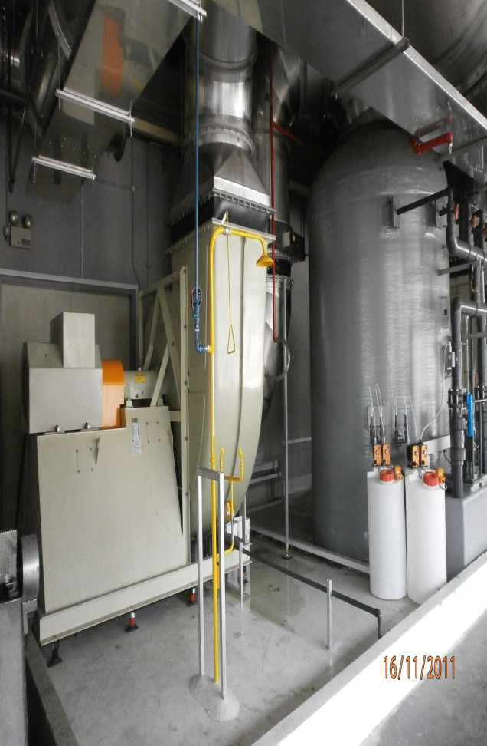
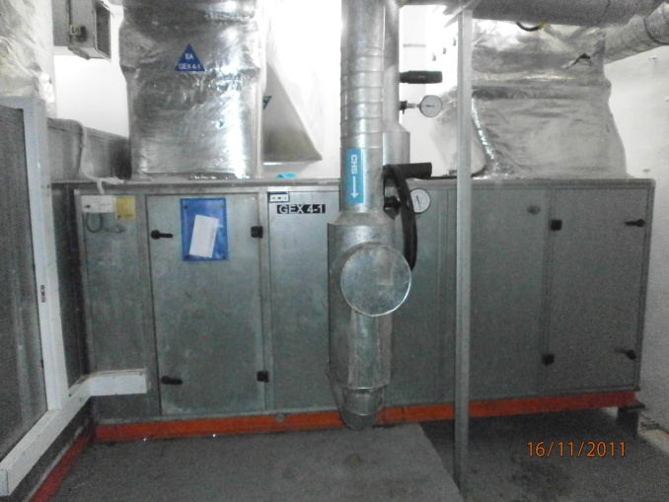
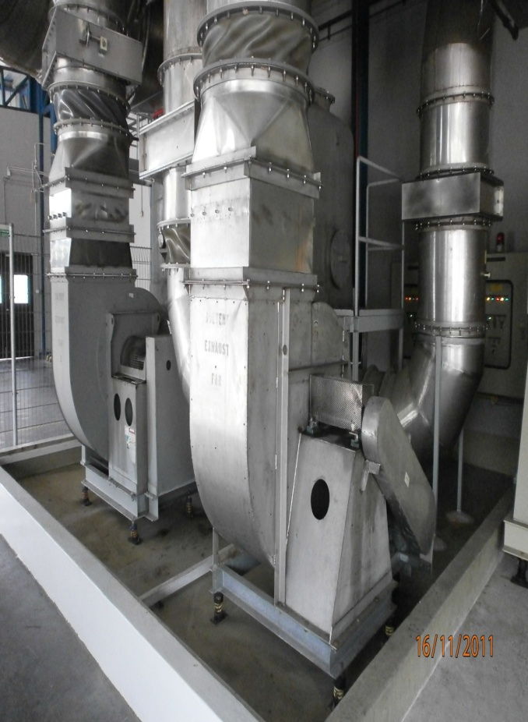
FACILITIES SYSTEM OVERVIEW
PROCESS EXHAUST SYSTEM
Acid Exhaust System
General Exhaust System
System Capacity
Major Components:
5 Packed bed Acid scrubber: 50,000cmh each
Utilization: 90%
4 Activated Carbon Solvent exhaust system: 17,000cmh each
Utilization: 75%
2 General Exhaust System: 41,000cmh each
Utilization: 70%
1 General Exhaust System: 30,000cmh each
Utilization: 75%
Solvent Exhaust System

Slide 19
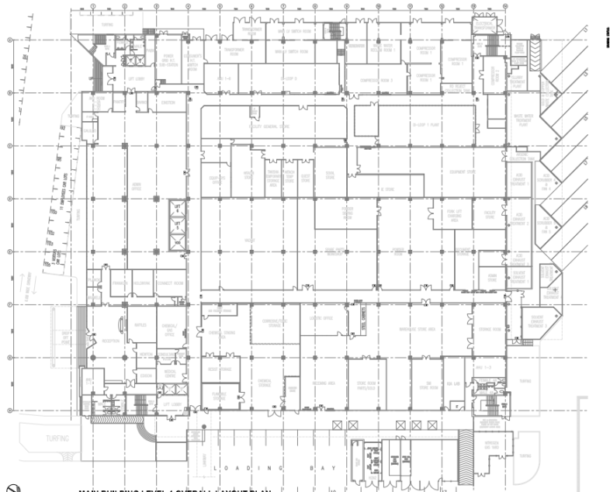
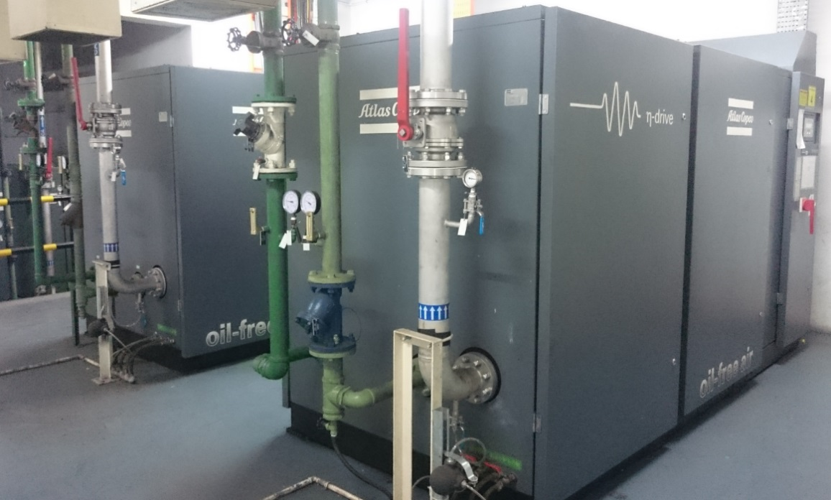
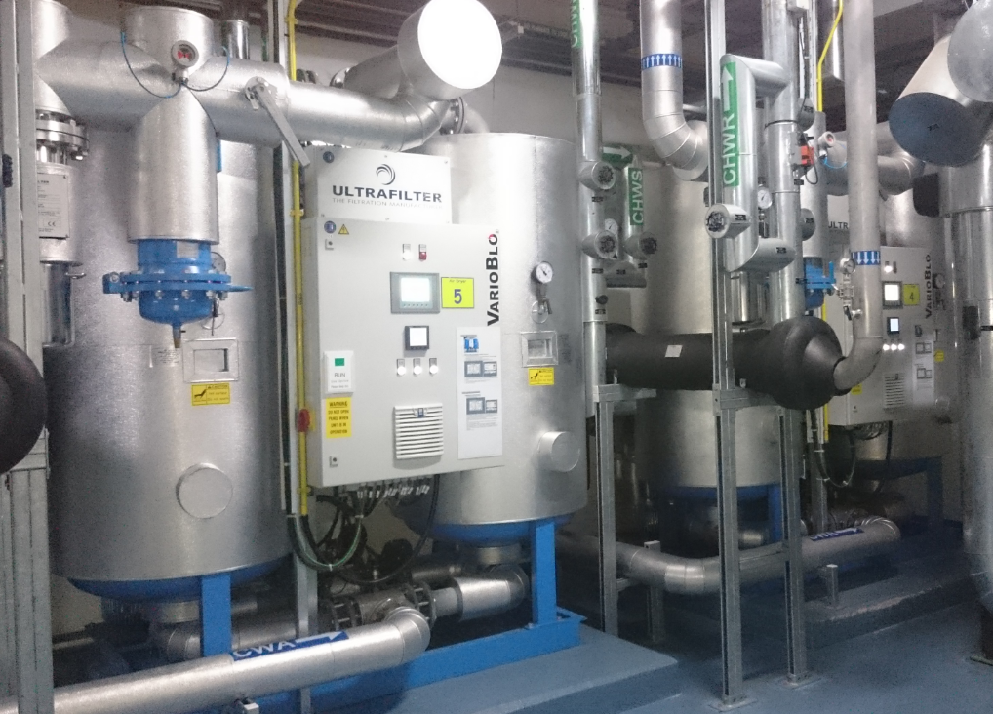
FACILITIES SYSTEM OVERVIEW
COMPRESSED DRY AIR (CDA)
LOADING BAY
MAIN BUILDING Level 1
CDA System Capacity 10800 m3/hr
Utilization: 52%
Major Components:
7nos of AtlasCopco compressors:
3 ZR315 VSD compressor 2700 m³/hr each
4 ZR160 compressor 1350 m³/hr each
5 dryers having total capacity of 14400 m³/hr
CDA Delivery pressure : 8.5 bar
Dew point : -80 ºC

Slide 20
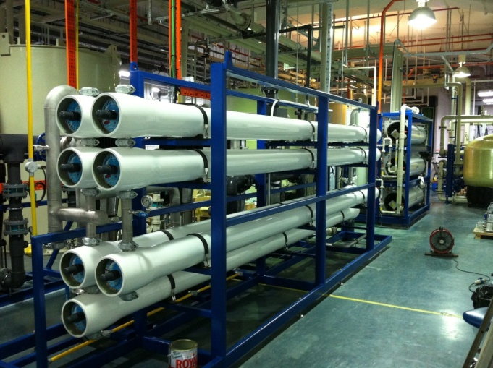
FACILITIES SYSTEM OVERVIEW
DEIONIZED WATER SYSTEM (DI)
LOADING BAY
MAIN BUILDING level 1
De-ionized Plant System
System Capacity 90m³/hr
Major Components: Utilization: 44%
DI LOOP 1 Plant Capacity: 100 m³/hr
RO capacity = 84 m³/hr
2 train, each train @ 42 m³/hr
Polishing loop capacity: 87 m³/hr
Plant unit operation:
Activated Carbon Filter, 2 pass RO, Continuous Electro-Deionization (CEDI), Ultraviolet System, Mixed Bed, Ultrafiltration (UF).
TOC<35ppb, Resistivity >18Mohm

Slide 21
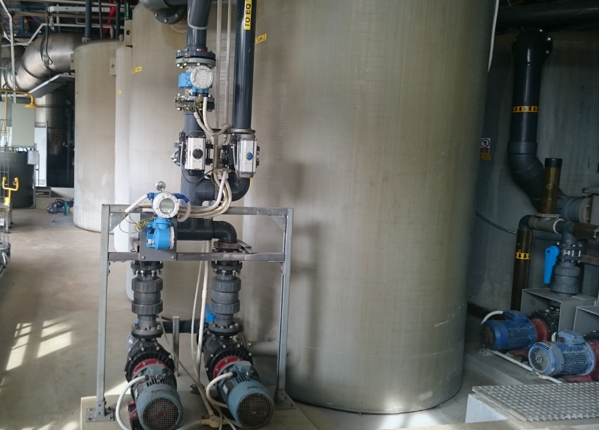
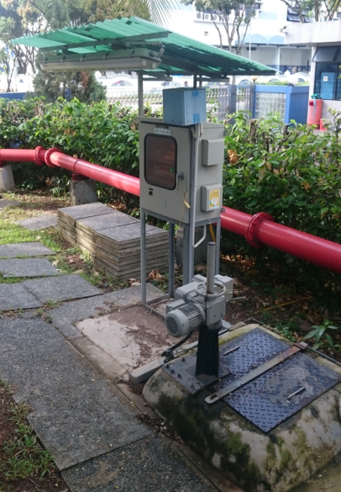
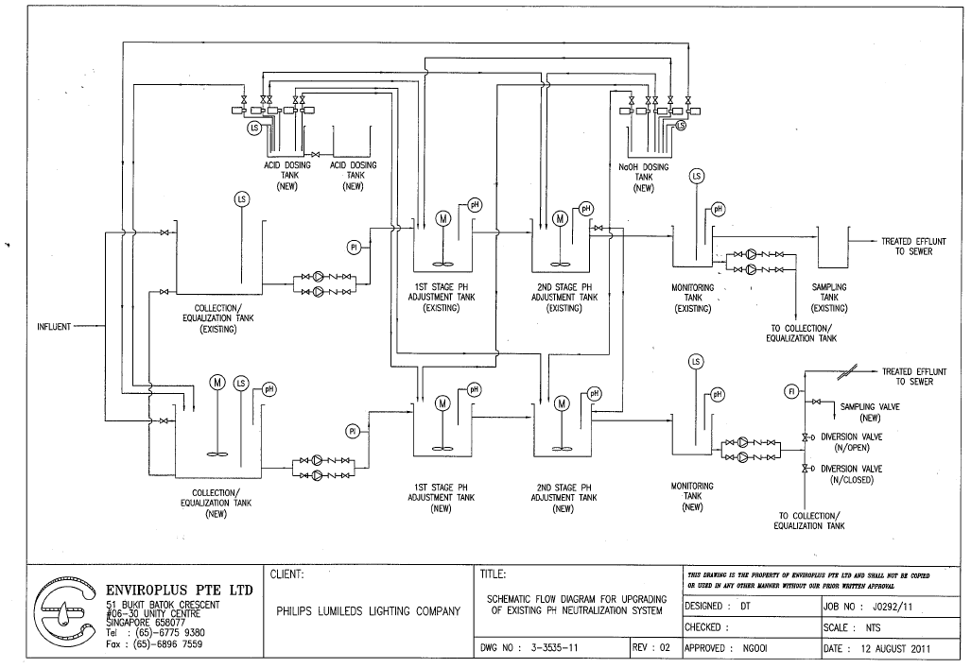
FACILITIES SYSTEM OVERVIEW
WASTE WATER TREATMENT PLANT (WWTP)
LOADING BAY
MAIN BUILDING level 1
System Capacity 90 m³/h
Major Components:
Utilization : 80%
2 Pass treatment running in parallel
pH control limit: 6 to 9

Slide 22
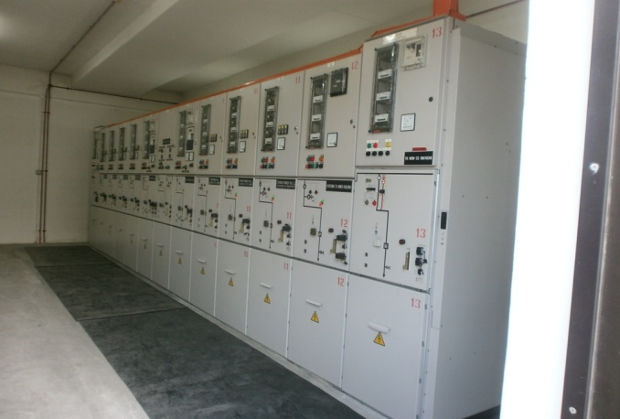
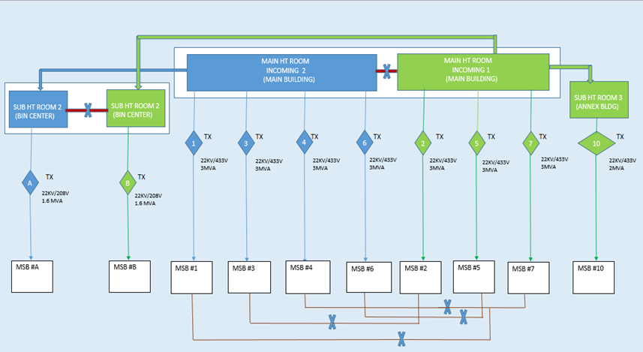
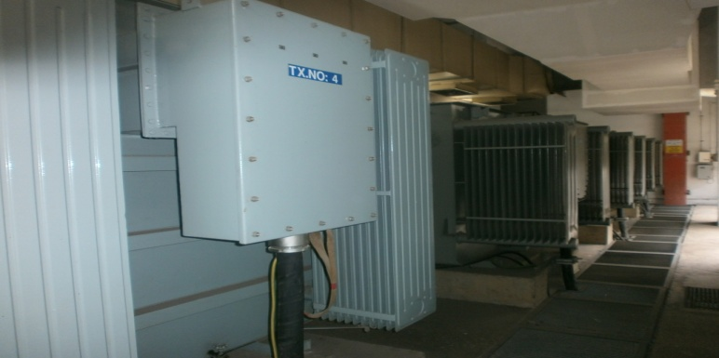
FACILITIES SYSTEM OVERVIEW
ELECTRICAL DISTRIBUTION
HT Switch board
System Capacity
Major Components:
2 Nos. of 22KV Incomers
7 Nos. of 22KV/433 V transformers 3000KVA each
2 Nos. of 22KV/208V transformers 1600KVA each
1 Nos. of 22KV/433V transformer 2000KVA each
HT Transformers

Slide 23
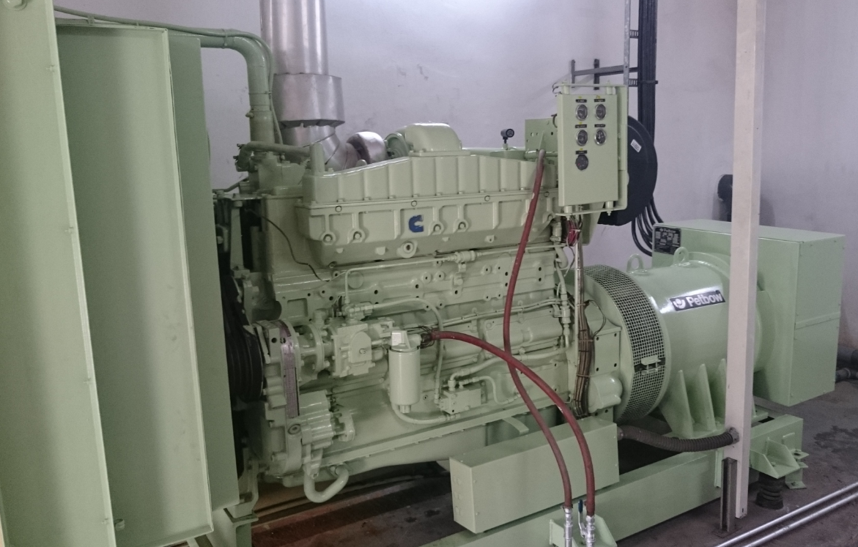
FACILITIES SYSTEM OVERVIEW
EMERGENCY GENERATOR
System Capacity
Major Components:
1 no Generator 350 KVA supporting main building
1 no Generator 150 KVA supporting Annex building
To support CRITICAL Facilities loads during power outage, through
2 nos of EMSB (Emergency Main Switch Board)
Generator able to support critical load for 8hrs before running dry

Slide 24
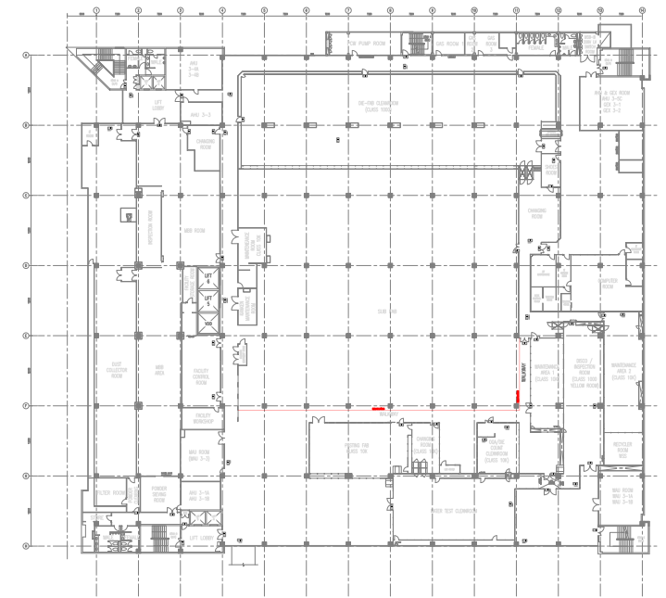
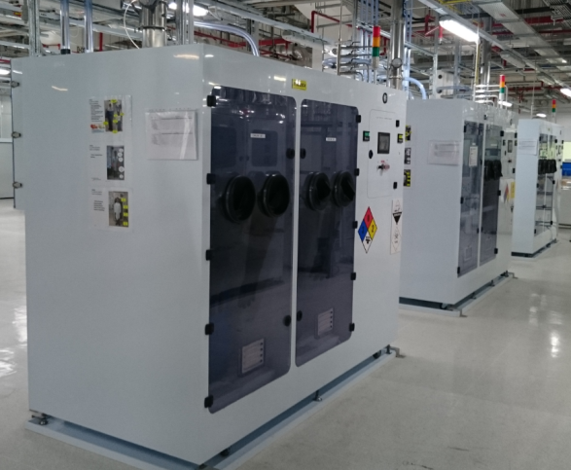
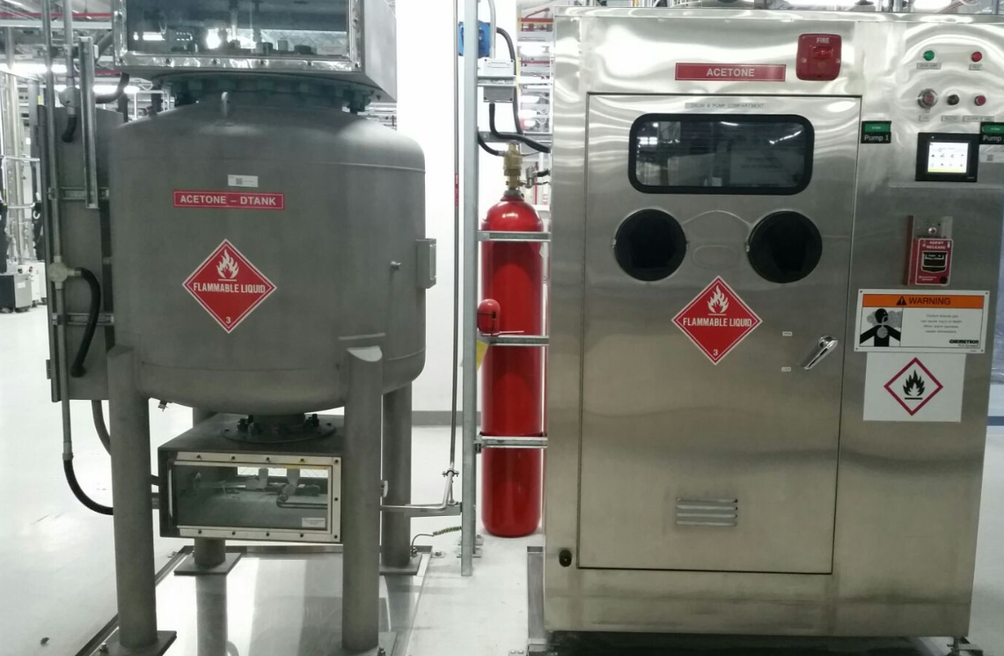
FACILITIES SYSTEM OVERVIEW
CHEMICAL DISTRIBUTION SYSTEM
Main Building L3 SubFab
Chemical Dispensing System
System Capacity
Major Components:
1%NH4OH
29%NH4OH
31% H2O2
81%H2SO4
96% H2SO4
ACETONE (500L Daytank)
ALEG368 (500L Daytank)
DECONTAM (1000L Daytank)
DYNASTRIP 7700
PMA
IPA * 2nos
BOE
KOH 20%
RR5

Slide 25
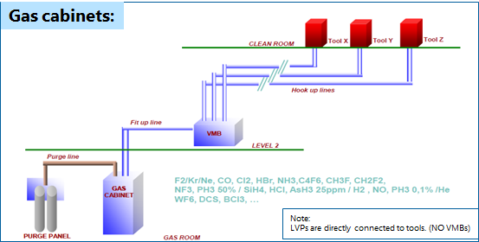
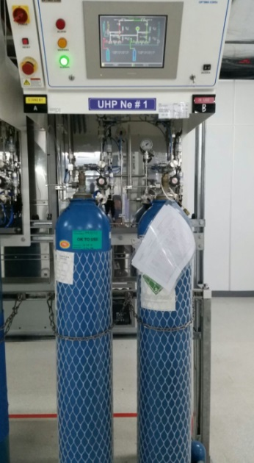
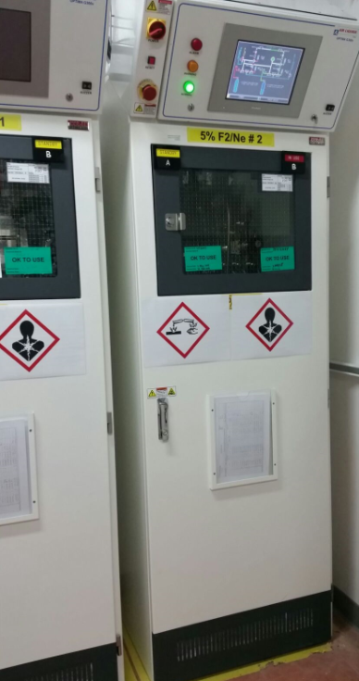
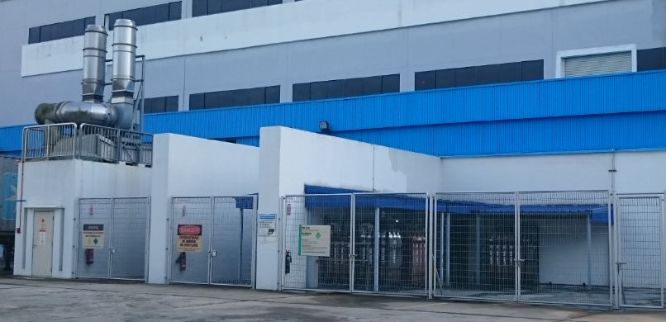
FACILITIES SYSTEM OVERVIEW
System Capacity
Major Components:
Total 110nos of gas distribution system
4%H2/N2
5%F2/Ne
5%H2/He
10%CH4/Ar
25%SiH4/He
100% SiH4
Argon
BCl3
C3F8
CHF3
CF4
Cl2
Helium
HBr
GAS DISTRIBUTION SYSTEM
NH3
Neon
Oxygen
SF6
SiCl4

Slide 26
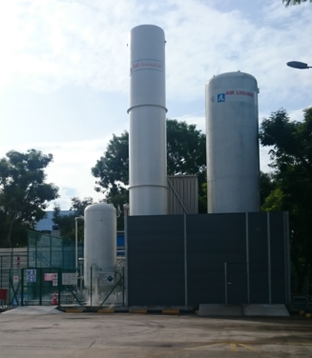
FACILITIES SYSTEM OVERVIEW
NITROGEN GENERATION PLANT
System Capacity 1800 m³/hr
Utilization: 66%
Major Components:
2nos ZR315 compressors at 900 m³/hr each
1no cooling tower
Nitrogen Spec: O2 < 2ppm ; Moisture < 2ppm

Slide 27
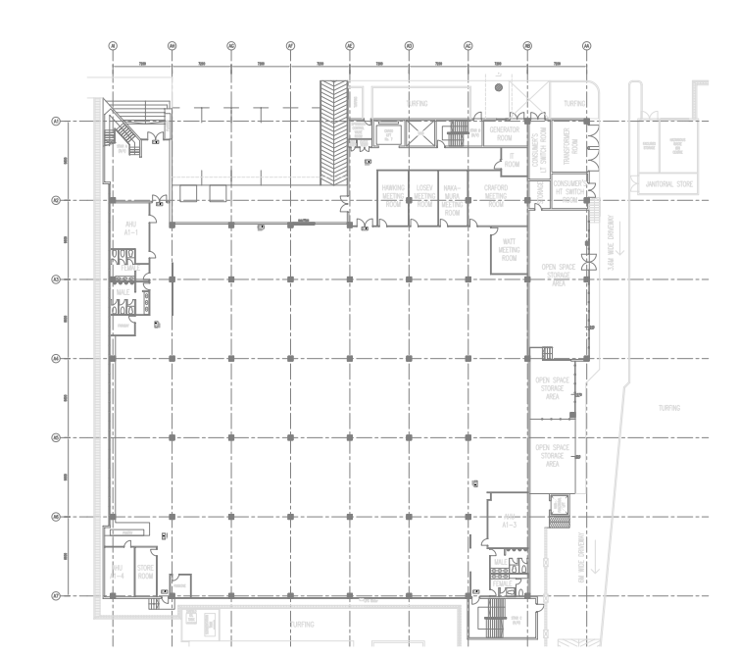
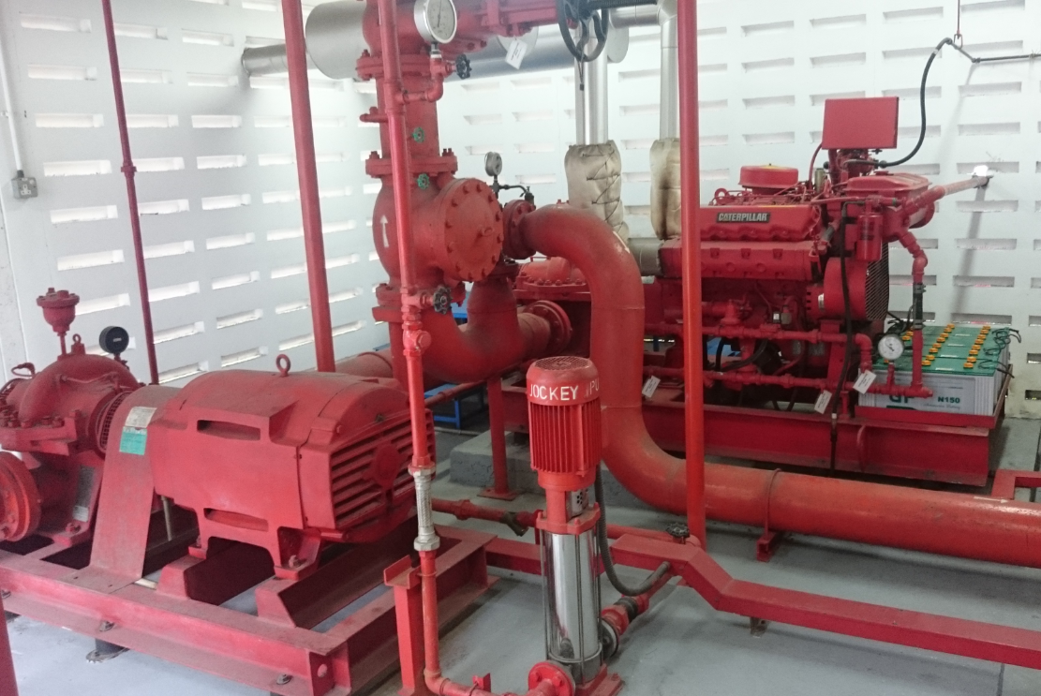
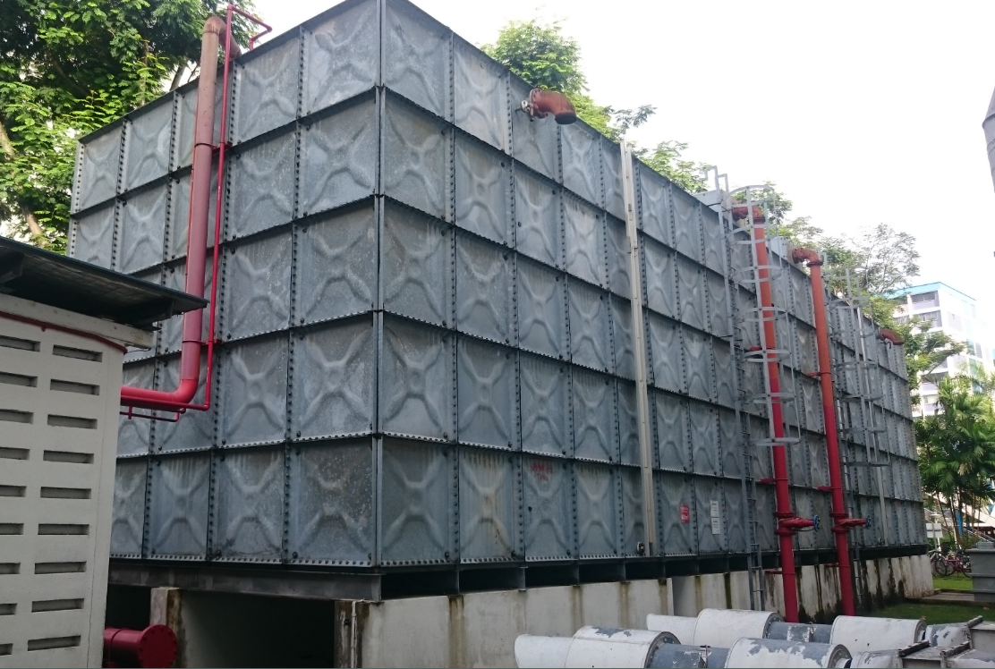
FACILITIES SYSTEM OVERVIEW
BUILDING SPRINKLER WATER SYSTEM
Proposed GYM
ANNEX Building Level 1
System Capacity
Major Components:
1 no Diesel pump 1500GPM (US)
1 no Electrical pump 1500 GPM (US)
1 no Jockey pump @112psig
2nos sprinkler water tank @ 350m³ each

Slide 28
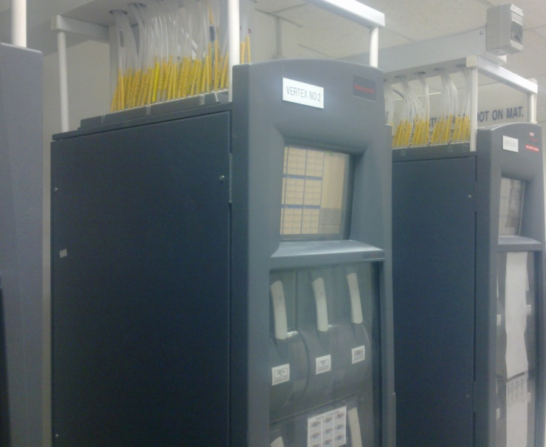
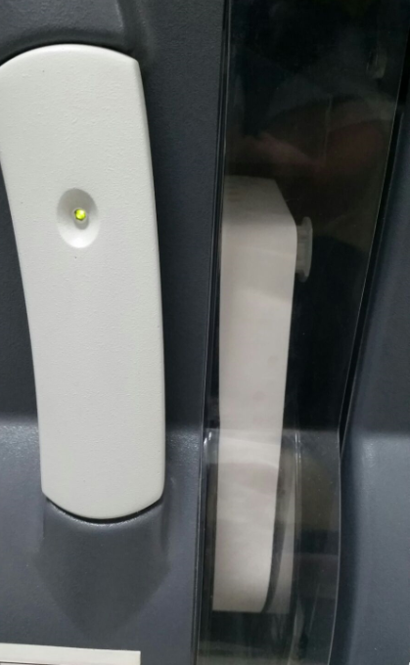
FACILITIES SYSTEM OVERVIEW
LIFE SAFETY SYSTEM
System Capacity
Major Components:
5nos of HONEYWELL VERTEX SYSTEM.
5nos of Hydride monitoring
8nos of Cl2 monitoring
3nos of NH3 monitoring
2nos of F2/Oxidiser monitoring
8nos of Mineral acid monitoring
LSS Vertex Analyzer

Slide 30
LUMILEDS SINGAPORE FACILITIES ORG CHART
FACILITIES – OPERATION & MAINTENANCE
OPERATIONS & MAINTENANCE & BUILDING SERVICES
SNR MANAGER
MR. WONG CHEE KEAT
CHEMICAL SYSTEM O&M
SNR ENGINEER
GAS SYSTEM O&M
SNR ENGINEER
CHEMICAL & GAS WAREHOUSE
SUPERVISOR
M&E OPERATION
ENGINEER
M&E MAINTENANCE
MANAGER
BUILDING SERVICES
SUPERVISOR
MR. ERIC CHONG
MR. REYNALDO
MS. GAN KAI LI
MR. YEO EDWIN
MR. KOW MUI HIANG
MR. TOCK KHENG LEONG

Slide 31
LUMILEDS SINGAPORE FACILITIES
OPERATIONS& MAINTENANCE & BUILDING SERVICES TEAM OVERVIEW
Key Responsibilities
Executing the day to day operation of the plant to its highest standard safely.
Ensuring end user with uninterrupted supply of utilities at the required performance level and specification.
Ensure stock level of chemical and gas inventories are healthy; provide timely escalation of abnormal consumption to end user.
Support production in dispensing of chemicals to production equipment and stocking up of the storage cabinet.
Ensure the chemical and gas distribution system are operated and maintained to its highest standard safely.
Carry out repair and troubleshooting on systems in an unplanned shutdown at the shortest period of time and to perform root cause analysis, implement action plan to prevent reoccurrence.
Maintaining the Facilities systems as per RIGOR guideline.
Enhancing system maintenance to prolong life cycle and improve efficiency; energy savings. (Cost efficient PM; spare parts obsolescence planning ; evaluating new technology)
Up keeping of building premises; fixtures and fittings.
Responding to and provide technical support to team members internally and externally as and when required.
Improving work efficiency/productivity/ enhance safety. A breakthrough in how a task is being performed.
FAC system strategy planning in achieving optimization in FAC operation.
Forecast Facilities Operations & Maintenance costing and budgeting.
Achieving best in class through the Operations Excellence program.

Slide 32
LUMILEDS SINGAPORE FACILITIES ORG CHART
FACILITIES – ENGINEERING
FACILITIES ENGINEERING
MANAGER
MR. ANANTHAN
ELECTRICAL & INSTRUMENTATION
SNR ENGINEER
MECHANICAL ENGINEERING (WATER &FAC PROCESSES)
CHIEF ENGINEER
MECHANICAL ENGINEERING (ACMV & FIRE PROTECTION)
SNR ENGINEER
MR. GIRI
MR. TOO HAN SIONG
MR. WIN

Slide 33
LUMILEDS SINGAORE FACILITIES
ENGINEERING TEAM OVERVIEW
Key Responsibilities:
Provide Engineering support to Projects & Tool install activities including preparation for Capex request. Assist in equipment/component qualification and selection.
Provide Engineering analysis and System design to ensure it meet the business needs, corporate insurer’s requirements and are regulatory code compliant.
Regular monitoring of all the Facility system’s capacity to track the utilisation level including Site’s Electrical power contractual demand.
Prepare facility equipment strategy plans to meet current and future requirements (System co-owner)
Provide technical support to Operations and Maintenance as & when required (Assist in Troubleshooting complex Mechanical, Electrical & Control system issues).
Periodic review of Engineering design & specification, SOPs, and facility drawings.
Lead the Energy & Water Conservation programs to meet both the EHS and cost savings KPIs.
Submit Energy/water consumption reports to Government Agencies like NEA, PUB.
Participate in the review of budgeting, forecasting, and on-going expenditures.

Slide 34
LUMILEDS SINGAPORE FACILITIES ORG CHART
FACILITIES – ENGINEERING
FACILITIES PROJECT & TOOL INSTALL MANAGER
MR. RAHMAN
PROJECT & TOOL INSTALL ENGINEER
TOOL MOVE & DRAFTING SUPERVISOR
MR. ZUL
MR. AHMAD

Slide 35
LUMILEDS SINGAPORE FAC INTRODUCTION
PROJECT AND TOOL INSTALL
Key Responsibilities:
Manage Project scope by defining goals with sufficient details to facilitate understanding, safe execution and good housekeeping standards
Study & Prepare cost estimates for new project requests, tools, production ramp scenarios
Manage time, cost and quality to ensure efficient handling of project and achieving the desired results
Coordinate with respective Business Case Owners to present new project capex requests
Facilitate new project tender process from tender document to bid analysis to project award
Lead team of contractors to execute projects and tool installations from design to construction to project closure
Liaise with tool owners to submit tool Facility Requirement Request (FRR)
Verification of submitted tool facility requests with Facilities engineers
Prepare cost estimates for new expense projects and tool install/de-install requests
Lead feasibility studies for tool hook-up/project requests
Manage telephone and LAN point installations requests for all areas

Slide 36
LUMILEDS SINGAPORE FACILITIES ORG CHART
FACILITIES – ENGINEERING
ENVIRONMENTAL & HEALTH SAFETY
MANAGER
MS. ROWENA
WORKPLACE HEALTH & SAFETY OFFICER
CHIEF ENGINEER
SAFETY OFFICER
ENVIRONMENTAL OFFICER
MS. JENNIFER
MR. JHUN
MS. DIAN

Slide 37
KEY RESPONSIBILITIES
Manage, implement and maintain EHS management system and programs to comply with legal and
other requirements and make employees engaged to continue achieve performance improvement
EHS
Environmental monitoring (boundary noise, waste discharge, air emission, hazwaste) | Internal Audit management system and monthly safety inspection
Facilitate and organize EHS Program Team and WSH Committee (Safety Improvement, Training and Promotion, Waste Recycling, Energy Conservation, Water Conservation, Outreach Program) | Emergency Response Team (drill, exercise, competency training, SCDF exercise, ERT PPE and materials)
Annual EHS medical monitoring (Audiometry, Arsenic, Manganese, X-ray users) | Industrial hygiene monitoring and assessment (chemical, dust and noise)
Sustainability/Corporate Reporting (Water, Energy, Waste, Chemical, Injury/Illness, Injury Preventable) | EHS Risk Management
External Audit (OHSAS 18001/ISO 14001, SS 577, SS 506, Insurer and customer) | Contractors Management (worker’s training, Permit To Work, monitoring)
Chemical Management (approval, assessment, SDS updating) | Operations EHS assessment (ergonomics, chemical, Electro/mechanical, process safety, PPE, Fire Safety)
License and Permit application (SCDF, NEA, MOM & other regulatory agencies) and quarterly x-ray badge monitoring | External communication to regulatory agencies (ad-hoc inspection, neighbor complaint, license)
Incident Management (investigation, CA/PA, improvement) | EHS Training Program (conduct training, records, training needs)
BCP
Business Continuity Management - Organize to establish procedures and documentation of Site BCP, Crisis Management Plan, Dept Risk Assessment, Dept Business Impact Analysis and Dept Business Continuity Plan. - Exercise and review of BC Plan - Training and workshop of BC Coordinators

