Slide 1
Process Exhaust Fundamentals
Basic Facilities Knowledge Package
Author: Kow Mui Hiang
Editor: Wong Chee Keat
Yr.2019

Slide 2
AGENDA
Causes of Air Polution and the effects
Industrial Exhaust Ventilation
Legal requirement
Process exhaust system and basic components
Process Exhaust – Our System
Q & A

Slide 3
Process Exhaust Fundamental - Air Pollution
Air pollution has been found to be present widely in the environment. There are a number of effects of this:
Biomagnification describes situations where toxins (such as heavy metals) may pass through trophic levels, becoming exponentially more concentrated in the process.
Carbon dioxide emissions cause ocean acidification, the ongoing decrease in the pH of the Earth's oceans as CO₂ becomes dissolved.
The emission of greenhouse gases leads to global warming which affects ecosystems in many ways.
Nitrogen oxides are removed from the air by rain and fertilise land which can change the species composition of ecosystems.
Smog and haze can reduce the amount of sunlight received by plants to carry out photosynthesis and leads to the production of tropospheric ozone which damages plants.
Sulfur dioxide and nitrogen oxides can cause acid rain

Slide 4
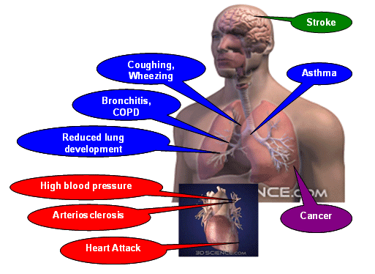
Air pollution
Overview of main health effects on humans from air pollution.
Short-term effects include irritation to the eyes, nose and throat, and upper respiratory infections such as bronchitis
and pneumonia. Other symptoms can include headaches, nausea, and allergic reactions.
Long-term health effects can include chronic respiratory disease, lung cancer, heart disease, and even damage to
the brain, nerves, liver, or kidneys. Adverse air quality can kill many organisms including humans. Ozone pollution can
cause respiratory disease, cardiovascular disease, throat inflammation, chest pain, and congestion.

Slide 5
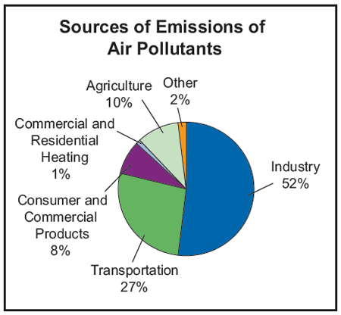
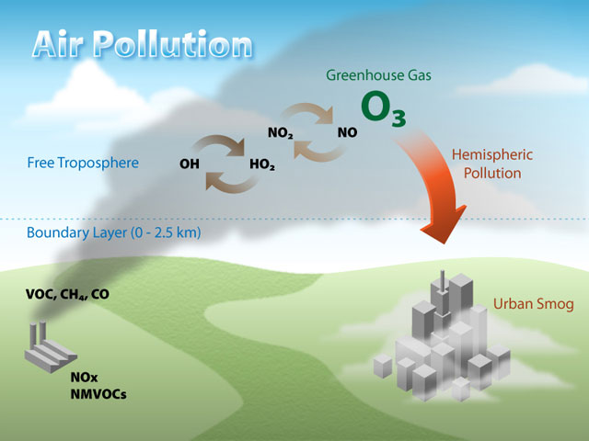
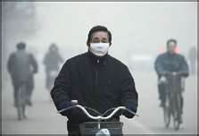
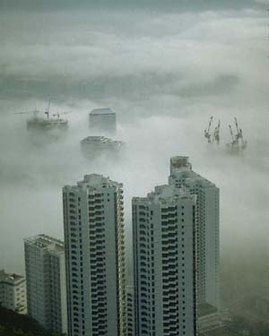
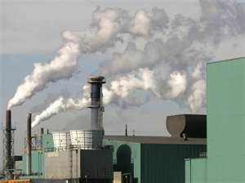
Air pollution – Environment Effect

Slide 6
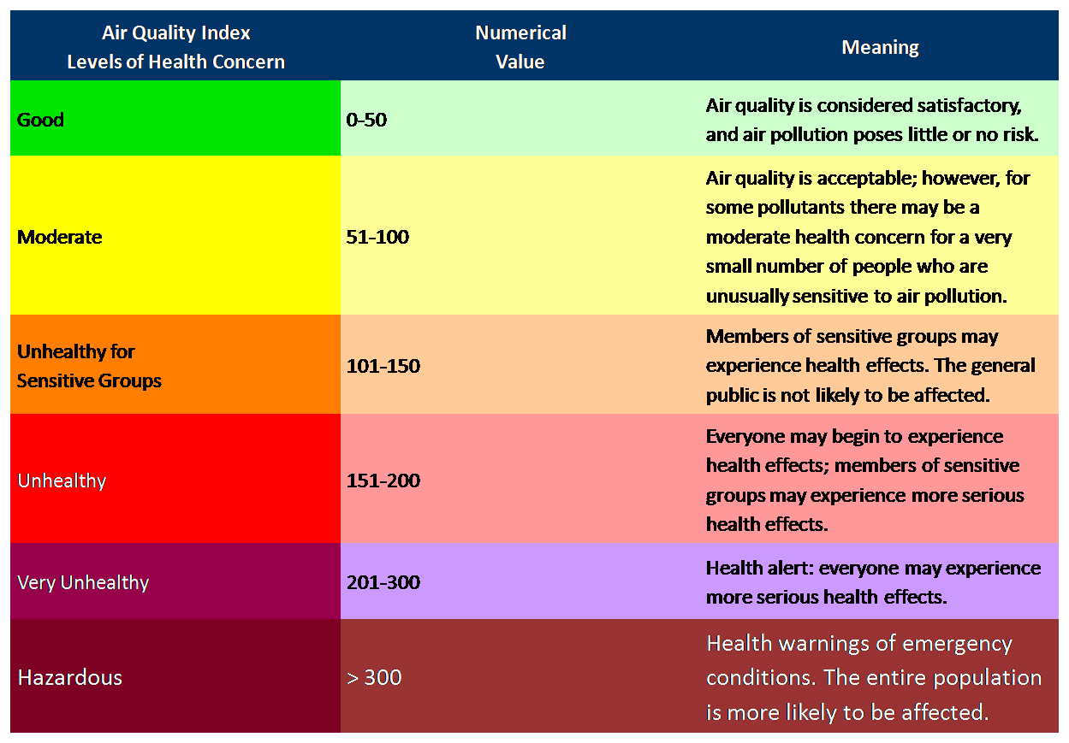
Air pollution – air quality index

Slide 7
What Is Industrial Exhaust Ventilation?
Environmental engineer’s view:
The design and application of equipment for providing the necessary conditions for maintaining the
efficiency, health and safety of the workers
Industrial hygienist’s view:
The control of emissions and the control of exposures
Mechanical engineer’s view:
The control of the environment with air flow. This can be achieved by replacement of contaminated air with
clean air.

Slide 8
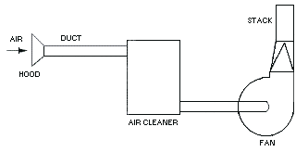
Application of Industrial Exhaust Systems
Prevention of environmental pollution
Reduction of occupational health disease occurrence.
Control of contaminants to acceptable levels.
Control of heat and humidity for comfort.
Prevention of fires and explosions.

Slide 9
Process Exhaust Fundamental
What is Process Exhaust Ventilation System ?
Systems are widely used to control Particulates, Toxic, Corrosive gases, Fumes, Mists, Odorous vapors & Heat from the various industrial operations and processes..
Why Process Exhaust Ventilation are needed?
A proper design of an exhaust system is necessary for the effective removal of airborne contaminants that would otherwise pollute the work place and factory as well as residential environment resulting in health hazards, or nuisance, or cause air pollution.
It is legal requirement, under section 14 and 59 of the factory act.

Slide 10
Legal Requirement & Scope
Legal requirement are under section 14 and 59 of the Factories Act.
Section 14 stipulates that where gases, vapors or other impurities are generated in the course of any process or work carried out in the workplace which may be injurious to health, an effective and suitable ventilation shall be provided for maintaining and securing the circulation of fresh air in the workplace, to render harmless so far as is practicable, all such gases, vapors or other impurities.
Section 59(1) stipulates that where any process or work carried on in any workplace is likely to produce or give off any toxic, irritating or offensive dust, fume or other contaminants, all practicable measures shall be taken to protect persons employed in the workplace against inhalation of the dust, fume or other contaminants; and prevent their accumulation.
Section 59(2) specifies that the measures to be taken shall, where appropriate, include providing local exhaust ventilation system to remove the dust, fumes, vapors, or other contaminants at their sources of emission.
Section59(3) states that the local exhaust ventilation system shall be so designed, constructed, operated and maintained that dust, fume, vapor, or other contaminants are safely and effectively removed at the source of generation and not dispersed or scattered in the surrounding air.

Slide 11
Process Exhaust Fundamental
Factory Discharge emission monitoring
Pollutants at the outlets of the General Exhaust, Solvent Exhaust and Acid Exhaust were to be compliance to the air impurities regulation stipulated by the Environmental protection & Management Act (NEA Environmental protection & Management (air impurities) regulations) and NEA Code of Practice on Pollution Control.
Pollutants to be monitored are: (mg/NM ³)
Chlorine & Fluorine (32/50) < 1.0
Nitrogen Oxide (700) <1.0
Hydrogen chloride (200) <0.5
Sulfuric acid and Nitric Acid (100/1000) <0.5
Arsenic & Ammonia (AEX only) (1.0/76) <0.02/0.5
IPA/Benzene (5.0) <1.0
CO (10) <1.0

Slide 12
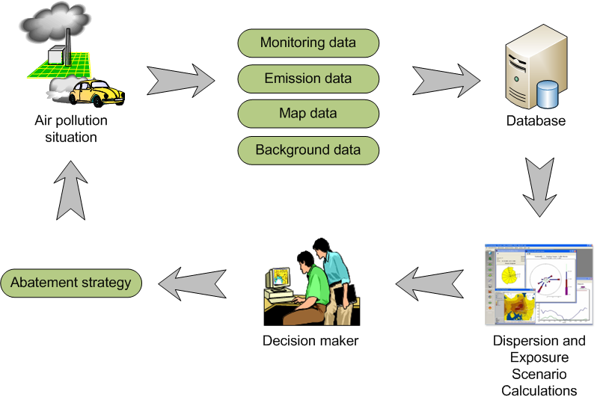
Process Exhaust Fundamental
Engineering Management and Control

Slide 13
Process Exhaust Fundamental
Pollutant control system
Dust collection systems
Baghouses
Cyclones
Electrostatic precipitators
Scrubbers
Baffle spray scrubber
Cyclonic spray scrubber
Ejector venturi scrubber
Mechanically aided scrubber
Spray tower
Wet scrubber

Slide 14
General Function of the Exhaust System
Selection of Exhaust system are mainly depend on the:
Industrial process
Condition , Quantity & Nature of the air pollutant
Gas/Air stream characteristic
Dust properties
Generally, there are four common types of Exhaust System used in the insdustrial
1. Acid Scrubber Exhaust System
Used for Acid fumes and Vapors removal such as HCL, HBr, Cl2, F2, HF, CO2, etc.
2. Ammonia Scrubber Exhaust System
Used for removal of NH3 only.
3. Solvent Scrubber Exhaust System
Used for the removal of corrosive and odorous gases & Vapors generated from the production plant
4. General Exhaust System
Used for removal of heat, dust, CO2 produced by the combustion chamber of the equipment.
Used to remove all non-contaminated substances.
In the event of Emergency it can be used to removed smoke and non-toxic and non corrosive gases.

Slide 15
Process Exhaust Fundamental
General Component of the Exhaust System
Exhaust Hoods
Exhaust Branch and Main Ducts
Centralize air cleaning abetment
Exhaust fan
Discharge stack
Industrial Exhaust ventilation system classified as:
Acid Scrubber Exhaust
Ammonia Scrubber Exhaust
Solvent Scrubber Exhaust
General Exhaust

Slide 16
Process Exhaust Fundamental
What is Scrubber ?
A scrubber system is a diverse group of air pollution control abatement that can be used to removed particulates and/or gas fumes from industrial exhaust stream and neutralize it before they are released into the environment.
What are the methods of scrubbing ?
Wet Scrubbing
Dry Scrubbing
Absorber
Combustion

Slide 17
Process Exhaust Fundamental
Wet Scrubbing
The pollutant stream is brought into contact with the scrubbing liquid solution.
Spraying pollutant stream with the liquid solution.
Force pollutants through a pool of liquid solution.
Liquid solution may simply be water or chemical reagents for neutralization.
Removal efficiency of pollutant is depends on the saturation time and the surface area of the liquid solution.
Dry Scrubbing
Usually Dry. Does not saturate pollutant streams that is being treated with moisture. No liquid solution is added.
Introduce the Alkaline / Acidic sorbent material into the pollutant stream by injection and spray nozzles.
Neutralize the harmful pollutant stream by chemical reaction.
Removal efficiency of pollutant is depends on the injection rate and the spray pattern.
Absorber abatement tower
Pollutants stream is passed through a cartridge or vessel filled with one or several absorber materials.
Media used are activated alumina compound impregnated with materials to handle specific exhaust gases.
Media can be mixed to offer a wide range of removal other odorous and corrosive gas fumes.
Removal efficiency depends on the saturation surface of the absorber.
Combustion Incinerator
Used of N2 or O2 to inject into the combustion chamber to burn away flue gases.
Removal of pollutants depend on oxidation or chemical reaction.

Slide 18
Process Exhaust Fundamental

Slide 19
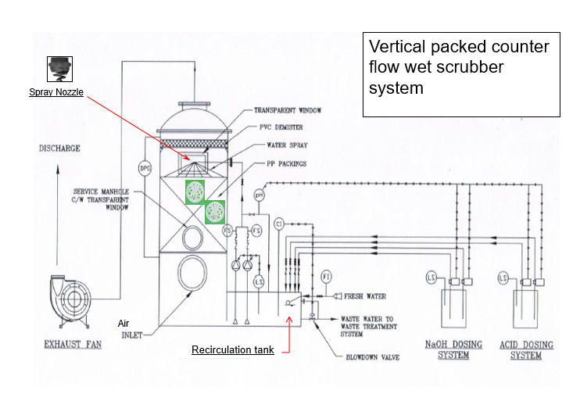
Process Exhaust Fundamental

Slide 20
Process Exhaust Ventilation - Our System

Slide 21
Acid Scrubber Exhaust System - Overview
The Acid Exhaust (AEX) fans are located at the Waste treatment & collection loading bay at level 1.
The AEX System serves to provide exhaust ventilation for the Production areas and Gas rooms, Gas cabinets at level 3 & 4.
There are 5 variable speed exhaust fans which is AEX #1, AEX #2, AEX #3, AEX #4, AEX #5
The total capacity of AEX is 250,000 CMH (5X50,000)

Slide 22
Acid Scrubber System Overview - Equipment
5 Numbers of Acid Scrubber ventilation units * Each acid scrubber unit consists of :
2 recirculation pumps with non-returned check v/v control
1 water re-circulation scrubber sump
1 Exhaust Fan with Exhaust Damper control
2 Acid Dosing pump with Acid tank
2 Caustic Dosing pump with Caustic tank
1 Vertical packed bed counter-flow wet scrubber
1 set of inlet and outlet air ducts

Slide 23
Process Description - Exhaust Fans
Acid Exhaust System serves to provide exhaust for the Production areas, Gas rooms and Gas cabinets
There are 5 VSD driven exhaust fans.
These exhaust fans exhaust the contaminated air from the clean room from level 3 to 4 and to maintained the static pressure at the main duct at 780Pa.
Exhaust fans can be start / stop at LCP (Local Control Panel) or from BAS.

Slide 24
Process Description- Scrubber System
Scrubber is air washer with refinement device which is used for cleaning gases from soluble or particulates.
It even treats fumes on line.
It effectively reduces concentration of water soluble acid, base and organics contaminants.
There are 3 LCPs installed for 3 scrubber units and respective exhaust fans.
LCPs are tie to the BAS control for remote control and monitoring.

Slide 25
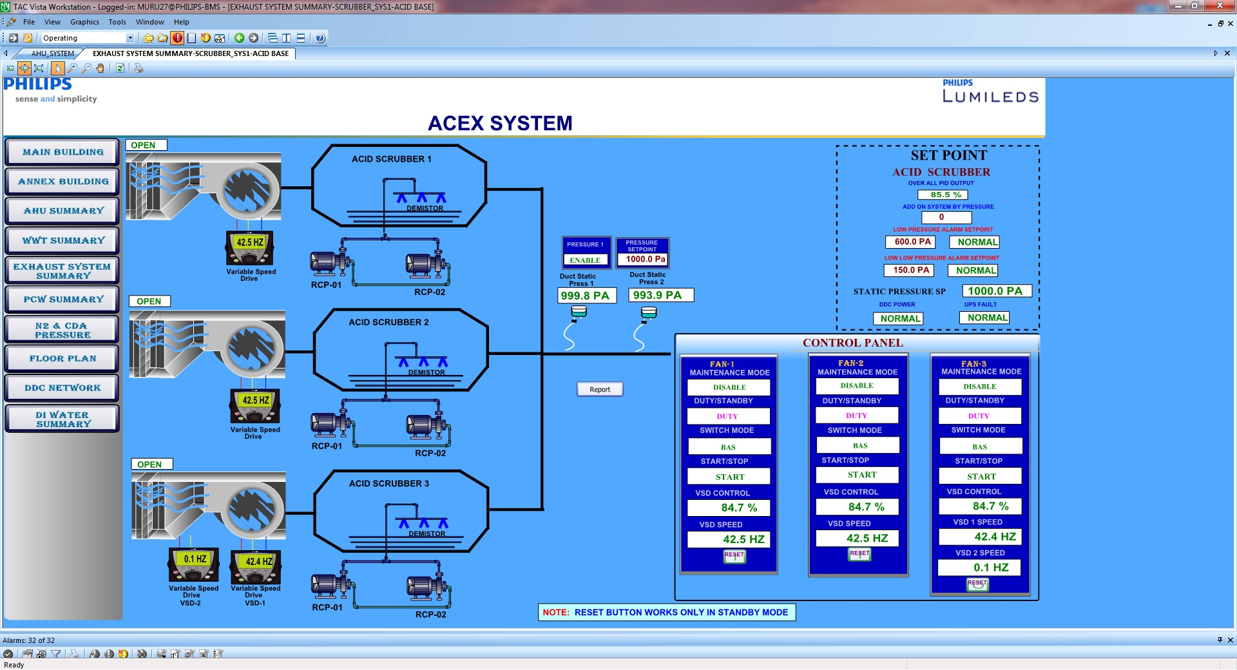
Facilities BAS control - Acid Scrubber Exhaust System

Slide 26
Process Exhaust Ventilation – Solvent Scrubber System

Slide 27
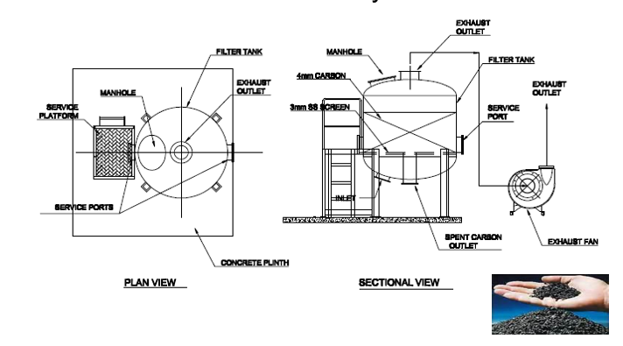
Process Exhaust Ventilation – Solvent Scrubber System

Slide 28
Process Exhaust Ventilation – Solvent Scrubber System
Equipment installed:
4 Numbers of Solvent Scrubber Exhaust.
Each solvent scrubber unit consists of :
1 Exhaust Fan with Exhaust Damper control
1 Vertical packed bed counter-flow dry activated carbon scrubber

Slide 29
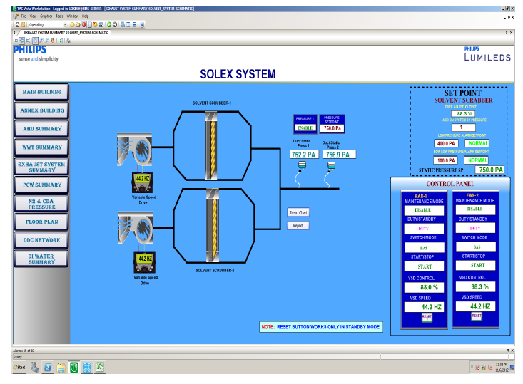
Process Description - Solvent Exhaust Fans
Solvent Exhaust System serves to provide exhaust for the production area.
There are 2 VSD driven exhaust fans.
These exhaust fans exhaust the contaminated air from the clean room from level 3 to 4 and to maintained the static pressure at the main duct at 900 Pa.
Exhaust fans can be start / stop at LCP (Local Control Panel) or from BAS.

Slide 30
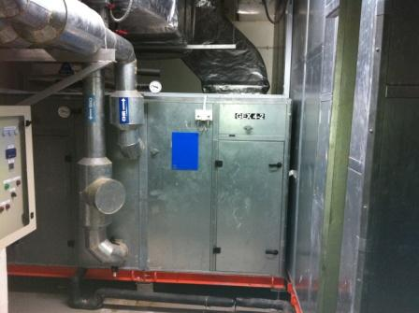
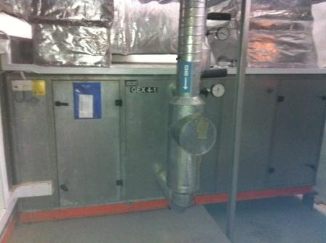
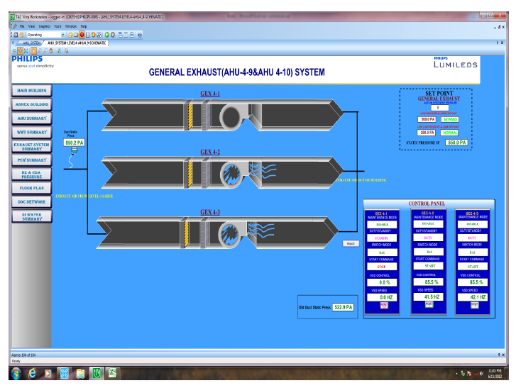
Process Exhaust Fundamental
Overview
The General Exhaust (GEX) fans are located in the GEX 4-1,4-2 and 4-3 room at level 4.
The GEX System serves to provide exhaust for the production area of the Lumileds at level 4.
There are 3 variable speed exhaust fans which is GEX 4-1,GEX 4-2 and GEX 4-3.
These exhaust fans exhausts the air from the equipment at level 4 saber area.
The total capacity of the GEX is 79,000 CMH

Slide 31
Process Exhaust Fundamental
There are advantages and disadvantages to the use of either dilution ventilation or local exhaust ventilation (Process Exhaust) in terms of costs and effectiveness.
DILUTION VENTILATION (MAU / AHU / Room Exh)
Advantages | Disadvantages
Usually lower equipment and installation costs. | Does not completely remove contaminants.
Requires less maintenance. | Cannot be used for highly toxic chemicals.
Effective control for small amounts of low toxicity chemicals. | Ineffective for dusts or metal fumes or large amounts of gases or vapors.
Effective control for flammable or combustible gases or vapors. | Requires large amounts of heated or cooled makeup air.
Best ventilation for small dispersed contaminant sources or mobile sources. | Ineffective for handling surges of gases or vapors or irregular emissions.

Slide 32
Process Exhaust Fundamental
There are advantages and disadvantages to the use of either dilution ventilation or local exhaust ventilation( Process Exhaust) in terms of costs and effectiveness.
LOCAL EXHAUST VENTILATION (AEX / SOLEX / GEX--)
Advantages | Disadvantages
Captures contaminant at source and removes it from the workplace. | Higher cost for design, installation and equipment.
Only choice for highly toxic airborne chemicals. | Requires regular cleaning, inspection and maintenance.
Can handle all sorts of contaminants including dusts and metal fumes.
Requires smaller amount of makeup air since smaller amounts of air are being exhausted.
Less energy costs since less makeup air to heat or cool.

