Slide 1
Compressed Dry Air Fundamentals
Basic Facilities Knowledge Package
Author: Yang Hai Xiang
Editor: Wong Chee Keat
Yr.2019

Slide 2
Introduction - CDA system
What a typical compressed air system looks like?
Typically compressed air system consists of
A supply side, which includes compressors and air treatment
A demand side, which includes distribution, storage systems and end-use equipment.
End use
Compressor #1
End use
Wet receiver
Dry receiver
Dryer
Filter
Compressor #2
End use
End use
Supply side
Demand side

Slide 3
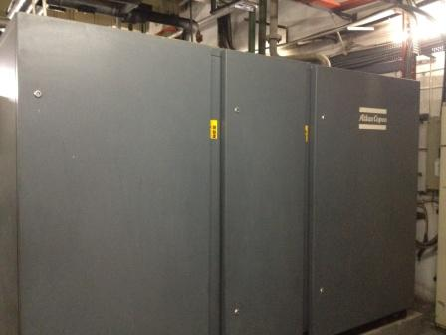
Introduction – Compressor
What is compressor?
Compressor is a machine that is used to increase the pressure of a gas, in other words compressor is a device that converts power into kinetic energy by compressing and pressurizing air. The basic working principle is that free or atmospheric air is compressed after reducing its volume and at the same time, increasing its pressure.
Major components of a compressor
Compressor, prime mover, controls, treatment equipment and accessories.

Slide 4
Free Air Delivery - FAD
Air intake at compressor inlet
Compressors are rated based on free air delivery
If a compressor is rated 100 CMH free air at 10 bar, it means that 100 CMH of air is taken at the inlet
Free Air Delivery, V1 = (V2 x P2 x T1) / (P1 x T2)
Example:
A machine uses 100 CMH of compressed air at 9 bar(absolute), if the compressed air supply to machine at 35 °C, what’s the FAD for compressor if ambient air is 30 °C 1 bar pressure.
V1 = (P2 x V2 x T1) / (P1 x T2)
= (9 x 100 x 303.15) / (1 x 308.15)
= 885.4 CMH
V1
P1
T1
V2
P2
T2
Compressor

Slide 5
Introduction – Compressor Type
Compressor types
There are two basic compressor types: positive-displacement and dynamic.
In the positive-displacement type, a given quantity of air or gas is trapped in a compression chamber and the volume it occupies is mechanically reduced, causing a corresponding rise in pressure prior to discharge.
Dynamic compressors impart velocity energy to continuously flowing air or gas by means of impellers rotating at very high speeds. The velocity energy is changed into pressure energy both by the impellers and the discharge volutes or diffusers.

Slide 6
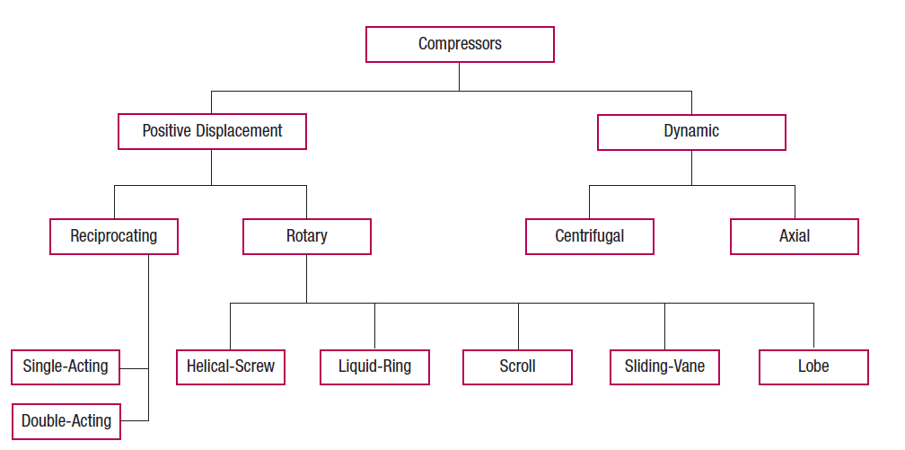
Introduction - Compressor Family Tree
Types of Compressor

Slide 7
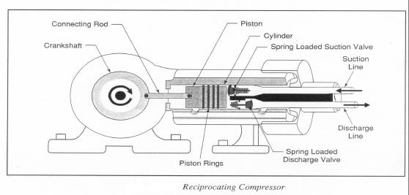
Introduction – Reciprocating Compressor
Reciprocating Compressor

Slide 8
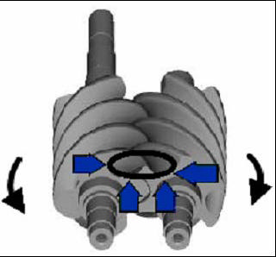
Introduction – Rotary Screw Compressor
There are two type of rotary screw compressors as lubricant-injected and lubricant-free screw compressor.
Air flowing in through the inlet port fills the spaces between the lobes on each rotor. Rotation then causes the air to be trapped between the lobes and the stator as the inter-lobe spaces pass beyond the inlet port. As rotation continues, a lobe on one rotor rolls into a groove on the other rotor and the point of intermeshing moves progressively along the axial length of the rotors, reducing the space occupied by the air, resulting in increased pressure.
The lubricant serves three functions:
(1) It lubricates the intermeshing rotors and associated bearings;
(2) it takes away most of the heat caused by compression; and
(3) it acts as a seal in the clearances between the meshing rotors and between rotors and stator.
A mixture of compressed air and injected lubricant is passed to a sump/separator where the lubricant is removed from the compressed air. Directional and velocity changes are used to separate most of the liquid. The remaining aerosols in the compressed air then are separated by means of a coalescing filter, usually only 2 – 5ppm of lubricant carry-over.
Dry type and water-injected type are available for lubricant-free compressor.

Slide 9
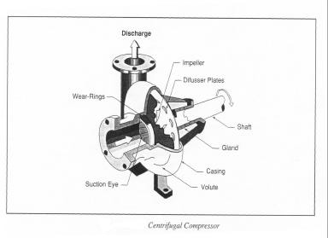
Introduction – Centrifugal Compressor
Dynamic compressors include centrifugal and axial types. It raises the pressure of air or gas by imparting velocity energy and converting it to pressure energy by means of a rotating impeller. Each impeller, rotating at high speed, imparts primarily radial flow to the air or gas which then passes through a volute or diffuser to convert the residual velocity energy to pressure energy.

Slide 10
Choose the right Compressors
Comparison of Compressors

Slide 11
Introduction – Air Receiver Tank & Sizing
Air receiver
Air receiver is essential to every compressed air system to act as a buffer and a storage medium between the compressor and the consumption system, and help control system pressure by controlling the rate of pressure change in a system. The main purpose of air receiver:
1. equalizing the pressure variation from the start/stop
2. storage of air volume equalizing the variation in consumption
3. collecting condensate
If this tank is properly sized, excessive cycling of compressor will be prevented, and adequate storage capacity for any peaks in demand will be provided, therefore energy saving.
Rules of sizing air receiver
1. By formula: V = (T x C x Pa) / (P1 - P2)
2. By good engineering practice:
1 gallon for each ACFM (Actual Cubic Feet per Minute), or
4 gallons per compressor hp
where
V = volume of the receiver tank (cu ft)
T= time for the receiver to go from upper to lower pressure limits (min)
C = air demand of free air (scfm)
p_{a}= atmosphere pressure (14.7 psia)
p₁ = maximum tank pressure (psia)
p₂ = minimum tank pressure (psia)
1 gallon = 0.0045 m3

Slide 12
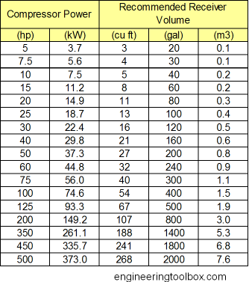
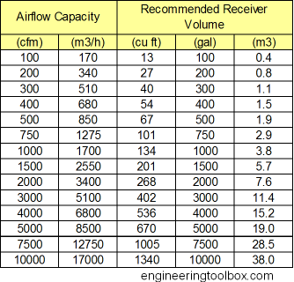
Size your Receiver Tank
Sizing of Air Receiver Tanks
The more air storage, the less energy used

Slide 13
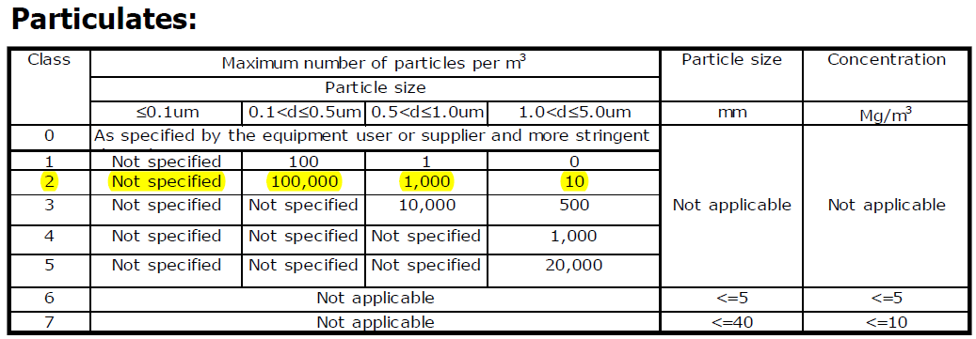
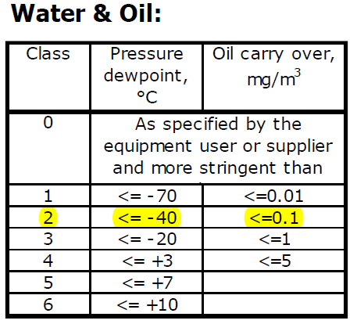
Classification of CDA
Air Quality
ISO8573-1:2001 defines the compressed air purity classes

Slide 14
Essential Parameters of CDA
Essential parameters of CDA to be monitored
Supply pressure
Our plant: 7.5barg ± 0.3barg
Dew point
Moisture can shorten component life, create rust, clog air lines and reduce air flow which all contribute to costly downtime.
Our Plant: < -70 °C
What’s Dew point?
The temperature at which water vapour in the air will condense.
Air contains moisture, when air is compressed, less moisture can be held by air. Lower the dew point, lower the moisture content in the air.
Moisture can be removed by:
After coolers (50 – 70%)
Dryers

Slide 15
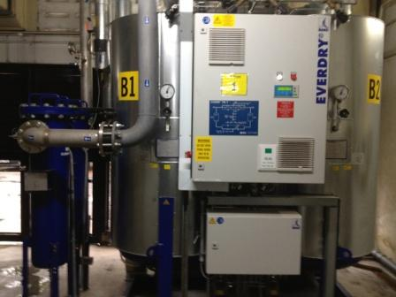
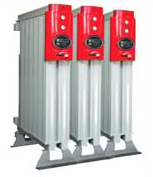
Introduction – Compressed Air Dryers
Dryer
There are 3 types of CDA dryers:
Desiccant,
Essential for lower dewpoint to -40 to -70°C, expensive to operate.
Refrigerant,
Low energy and capital cost provide pressure dewpoint to +3°C
Drying compressed air beyond the required pressure dew point will result in
unnecessary energy and costs.
Desiccant dryers
Refrigerant dryers

Slide 16
Compressed Dry Air (CDA) is Not Free !
Compressed Dry Air (CDA) system is an energy intensive utility, often represent the largest or 2nd largest end use of electricity in industrial plants. Not only is energy required for the compression process, but once the air is compressed to the desired pressure, it often has to be dried and cooled before it is sent through the distribution system to the end use, requiring even more energy.
Compressed Dry Air (CDA) is NOT free, it’s an expensive resource – Do NOT waste it.

Slide 17
Good Practices to keep CDA System Efficient
Some good practice to keep Compressed Air System efficient
Reduce supply pressure, 1barg reduction in pressure setting result in 4% energy saving.
Eliminate inappropriate application, e.g. open blowing for cooling, drying, clean up etc
Find & eliminate leaks, total leakage can be estimated by
Leakage (%) = [(T x 100)/(T+t)]
where: T = on-load time (minutes)
t = off-load time (minutes)
(Reduced system pressure will result in reduced leakage rates.)
Improve system control, the objective of control strategy is to shut-off unneeded compressors and delay bringing on additional compressors until needed. All units that are operating should be run at full-load, except one unit for trimming.
Minimize pressure drop across filters
Every 0.025Bar pressure drop increase across filters, there will be 2% more power consumption on compressors.
Lower the intake air temperature
Every 4 °C rise in inlet air temperature results in a higher power consumption about 1-2%, vice versa.

