Slide 1
Chilled Water System Fundamentals
Basic Facilities Knowledge Package
Author: Yang Hai Xiang
Editor: Wong Chee Keat
Yr.2019

Slide 2
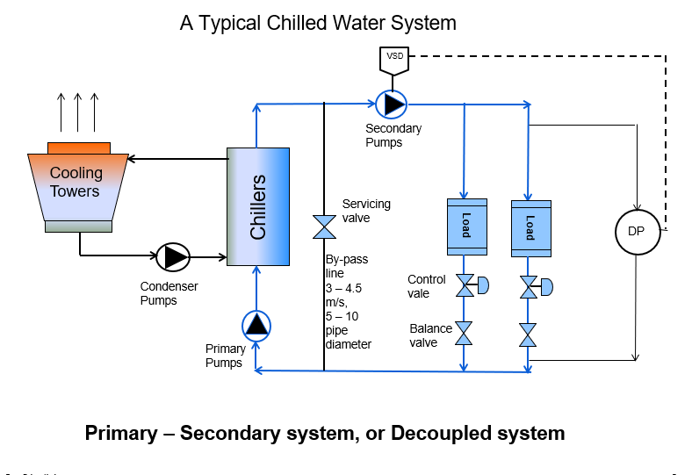
A Typical Chilled Water System

Slide 3
Primary – Secondary System
This system is unique, because it dedicates separate pumps for ‘Production (Primary)’ and ‘Distribution (Secondary)’ loops.
A bypass pipe that connects the supply and return pipes is the key component in decoupling the system.
The chillers in the production loop receive a constant flow of water, while the coils in the distribution loop, controlled by two-way modulating valves, receive a variable flow of water.
The purpose of the bypass pipe is to hydraulically decouple the production (primary) and distribution (secondary) pumps. Because water can flow freely between the supply and return pipes for both loops, a change in flow in one loop does not affect the flow in the other loop.
Total decoupling is accomplished only if the bypass pipe is free from restrictions and large enough to produce no pressure loss at all flow rates.

Slide 4
Primary – Secondary system
Each of the primary pump is turned on and off with its respective chiller.
Supply water temperature is maintained by the controls supplied with the chiller.
Because each chiller has a dedicated pump, the chillers can have different evaporator pressure drops, the chillers can be of any type, size, or age, or even from different manufacturers.
The distribution pump is typically equipped with a variable-speed drive that is controlled to maintain a certain pressure difference between the supply- and return-water piping.

Slide 5
Water Chiller
Water chillers are used in a variety of air conditioning and process cooling applications.
The water first was cooled by chiller, subsequently transported by pumps and pipes through cooling coils in air-con system, or heat exchangers in other process etc.
Chiller type:
Vapor-compression refrigeration cycle
Absorption refrigeration cycle
Absorption water chillers use heat to drive the refrigeration cycle. They do not have a mechanical compressor involved in the refrigeration cycle.
The compressor used in vapor-compression refrigeration cycle water chiller are commonly reciprocating, scroll, helical-rotary, and centrifugal compressors.

Slide 6
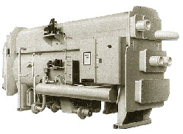
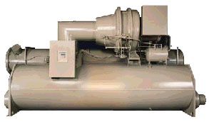
Water Chiller
Centrifugal water chiller
Absorption water chiller

Slide 7
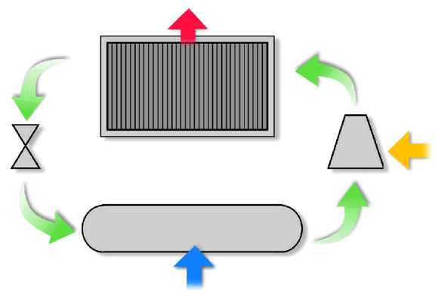
Vapor-compression cycle
reject heat
4
3
condenser
compressor
expansion
device
energy in
evaporator
1
2
absorb heat
7

Slide 8
Vapor-compression cycle
Refrigeration cycle
At point 1: Low pressure, mixture of liquid and vapor
At point 2: Low Pressure, vapor
At point 3: High pressure, hot vapor
At point 4: High pressure, cold vapor

Slide 9
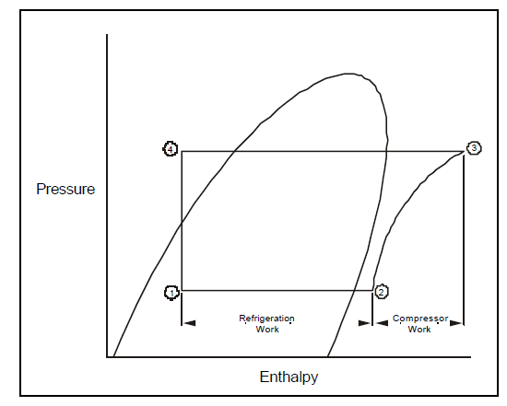
Vapor-compression cycle, Pressure-Enthalpy diagram
Refrigeration circuit, P – H diagram

Slide 10
Vapor-compression cycle, Pressure-Enthalpy diagram
Evaporator process, from point 1 to point 2. The refrigerant changes from liquid to gas, the pressure stays constant. The heat is being absorbed as a phase change, the refrigeration effect is the change in enthalpy from 1 to 2.
Compression process, from point 2 to point 3. The work is the change of enthalpy from 2 to 3 times the refrigerant flow rate. Compressors end up with the work of compression as heat in refrigerant and pressure rise at point 3.
De-superheating process, from point 3 to point 4. when condensation occurs the saturated refrigerant gas change to liquid. The line is horizontal indicates the pressure remains constant.
Expansion process, from point 4 to point 1. When refrigerant passes through the expansion valve, pressure and temperature will drop.

Slide 11
Application of different vapor-compression chiller
The reciprocating compressor was the workhorse of the small chiller market for many years. It was typically available in capacities up to 100 tons.
Scroll compressors have emerged as a popular alternative to reciprocating compressors, and are generally available in capacities up to 15 tons for use in water chillers. As with reciprocating compressors, multiple scroll compressors are often used in a single chiller to meet larger capacities. In general, scroll compressors are 10 to 15 percent more efficient than reciprocating compressors and have proven to be very reliable, primarily because they have approximately 60 percent fewer moving parts than reciprocating compressors. Reciprocating and scroll compressors are typically used in smaller water chillers, those less than 200 tons.

Slide 12
Application of different vapor-compression chiller
Helical-rotary (or screw) compressors have been used for many years in air compression and low-temperature-refrigeration applications. They are now widely used in medium-sized water chillers, 50 to 500 tons. Like the scroll compressor, screw compressors have a reliability advantage due to fewer moving parts, as well as better efficiency than reciprocating compressors.
Centrifugal compressors have long been used in larger water chillers. High efficiency, superior reliability, reduced sound levels, and relatively low cost have contributed to the popularity of the centrifugal chiller. Centrifugal compressors are generally available in prefabricated chillers from 100 to 3,000 tons, and up to 8,500 tons as built-up machines.

Slide 13
Cooling Tower
Cross Flow
Counter Flow

Slide 14
Cooling Tower
A cooling tower is a device commonly used to cool condensing water. Warm water is sprayed over fill in the cooling tower while a propeller fan draws outdoor air upward through the fill. The movement of air through the spray causes some of the water to evaporate, a process that cools the remaining water. This cooled water then falls to the tower sump to be returned to the condenser.
The final temperature of the water leaving the tower is determined partly by the humidity of the outdoor air. If the outdoor air is dry, the final water temperature can be considerably lower than the ambient dry-bulb temperature. If the outdoor air is humid, however, the final temperature will be near the ambient dry-bulb temperature.
As the water evaporates, the dissolved minerals and water treatment chemicals become concentrated in the sump. To prevent this solution from becoming concentrated and possibly corrosive, water is periodically blow down from the sump.

Slide 15
Cooling Tower
Cooling towers are rated in terms of approach and range, where
The approach is the difference in temperature between the cooled-water temperature and the entering-air wet bulb temperature
The range is the temperature difference between the water inlet and exit states
Cooling Tower Efficiency
The cooling tower efficiency can be expressed as
μ = (t_{i} - t_{o}) 100 / (t_{i} - t_{wb}) (1)
where
μ = cooling tower efficiency - common range between 70 - 75%
t_{i} = inlet temperature of water to the tower (ºC, ºF)
t_{o} = outlet temperature of water from the tower (ºC, ºF)
t_{wb} = wet bulb temperature of air (ºC, ºF)

Slide 16
Centrifugal Pump
A centrifugal pump is a rotodynamic pump that uses a rotating impeller to increase the pressure and flow rate of a fluid. Centrifugal pumps are the most common type of pump used to move liquids through a piping system. The fluid enters the pump impeller along or near to the rotating axis and is accelerated by the impeller, flowing radially outward or axially into a diffuser or volute chamber, from where it exits into the downstream piping system. Centrifugal pumps are typically used for large discharge through smaller heads.

Slide 17
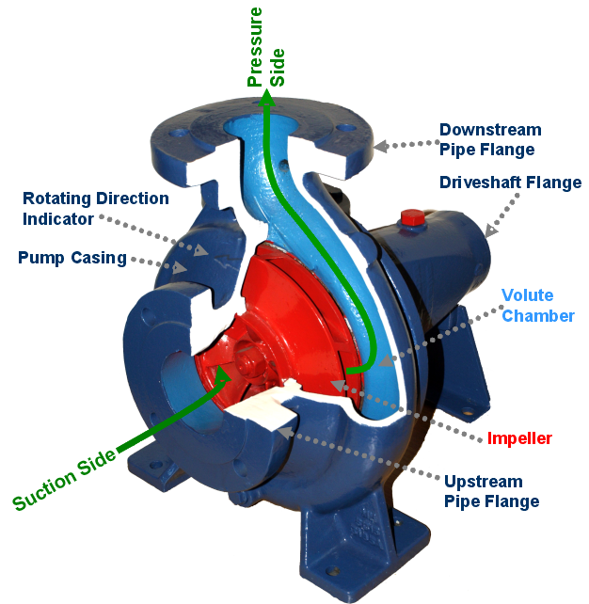
Centrifugal Pump

Slide 18
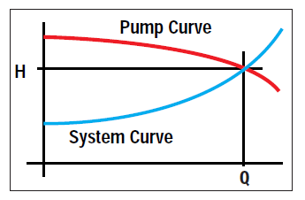
System curve and pump curve

Slide 19
System curve and pump curve
System curve represents the pressure needed at different flow rate to move the fluid through the system.
A centrifugal pump curve is the characteristic described graphically by the manufacturer as pump performance curve. The pump curve describes the relation between flowrate and head for the actual pump.
The head capacity can be increased by connecting two or more pumps in series, or the flow rate capacity can be increased by connecting two or more pumps in parallel.

