Slide 1
ACMV Fundamentals
Basic Facilities Knowledge Package
Author: Yang Hai Xiang
Editor: Wong Chee Keat
Yr.2019

Slide 2
ACMV Fundamental Knowledge
What is ACMV or HVAC?
ACMV is an abbreviation of: Air Conditioning and Mechanical Ventilation
HVAC is an abbreviation of: Heat, Ventilation and Air Conditioning
ACMV / HVAC systems provide forced ventilation of facilities with ‘conditioned’ air
Air conditioning implies control of Temperature (°C) and Humidity (%RH)
‘Conditioning’ may involve
Heating & Cooling
Humidification & Dehumidification
Filtration

Slide 3
ACMV Fundamental Knowledge
Why is ventilation necessary ?
Air to breathe
Prevents oxygen depletion
Removal of gases
Removal of Odours
Comfortable Working Environment
Usually removal of heat from:
People
Lights
Equipment
Contamination Control
Airborne dust kept to a minimum
Controlled particulate limits

Slide 4
ACMV Fundamental Knowledge
Air change rates
Supply and extract from a room leads to a “turnover” of air, known as the Room Air Change Rate
Room Air Change Rate = Supply Air Volume Flow (air changes per hour)
Room Volume
Higher air change rates give faster dilution and removal of airborne contaminants, and hence cleaner room conditions
The sources of contamination are mainly but not limited to
Outside Air
Pollution
Dust
Pollen
Equipment
Non-viable particulates
Lubricants
Humans
Viable particulates (EM)
Non-viable particulates
Breathing
Perspiration

Slide 5
ACMV Fundamental Knowledge
Cleanroom Industry Design Thumb Rule for ACR
ISO | Class | Fed 208 Control | Air Changes Rate per Hour
1 | - | Stringent | > 750
2 | - | Stringent | > 750
3 | 1 | Stringent | > 750
4 | 10 | Stringent | 500 - 600
5 | 100 | Stringent | 150 - 400
6 | 1,000 | Intermediate | 60 - 100
7 | 10,000 | Intermediate | 25 – 40
8 | 100,000 | Less Stringent | 10 - 15

Slide 6
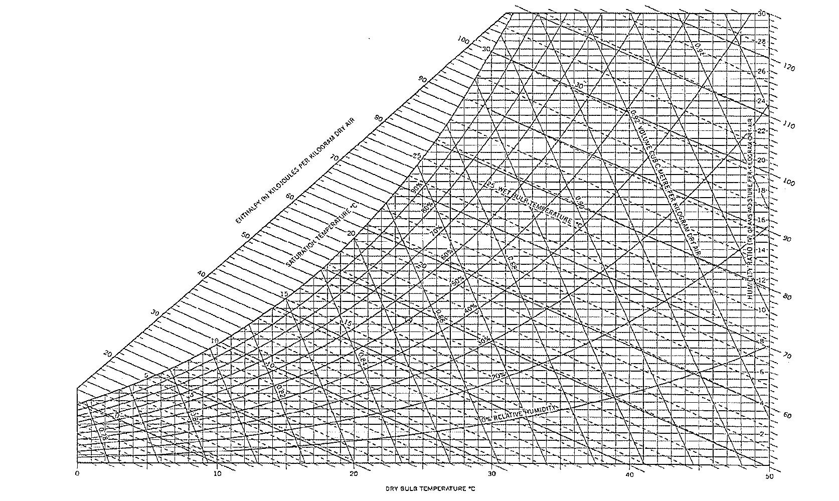
ACMV Fundamental Knowledge
The Psychrometric Chart
Psychrometry is the science dealing with the physical laws of air – water mixtures.
Properties of Air
Dry-bulb temperature
Wet-bulb temperature
Dew-point temperature
Relative humidity
Humidity ratio
Specific Volume
Enthalpy

Slide 7
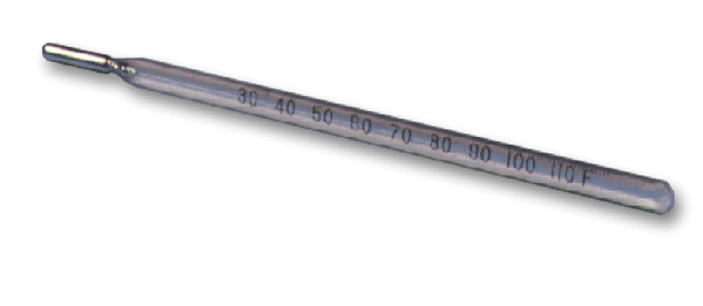
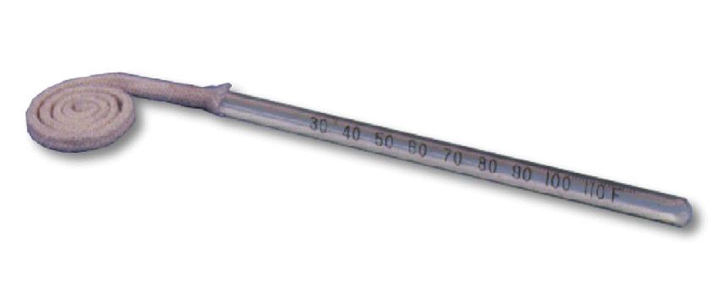
ACMV Fundamental Knowledge – Air Properties
Dry Bulb Temperature (T_{db})
Dry-bulb temperatures are read from an ordinary thermometer that has a dry bulb
Wet Bulb Temperature (T_{wb})
Wet-bulb temperatures are read from a thermometer whose bulb is covered by a wet wick
Dew Point temperature (T_{dp})
Dew-point temperature is the temperature at which moisture leaves the air and condenses on objects.

Slide 8
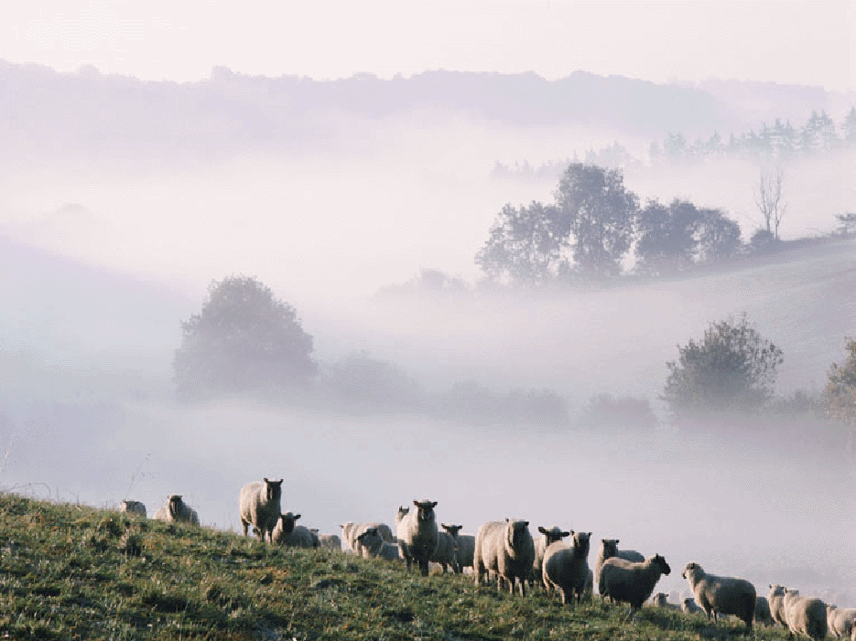
ACMV Fundamental Knowledge – Air Properties
Saturated Air
When the dry-bulb, wet-bulb, and dew-point temperatures are the same, the air is saturated. It can hold no more moisture. When air is at a saturated condition, moisture entering the air displaces moisture within the air. The displaced moisture leaves the air in the form of fine droplets. When this condition occurs in nature, it is called fog.
Relative humidity (Φ),
is a comparison of the amount of moisture that a given amount of air is holding, to the amount of moisture that the same amount of air can hold, at the same dry-bulb temperature. Relative humidity is expressed as a percentage

Slide 9
ACMV Fundamental Knowledge – Air Properties
Humidity ratio (ω)
Describes the actual weight of water in an air–water vapor mixture. In other words, it’s mass of water vapor present in a unit mass of dry air.
Sometimes called Absolute Humidity, Specific Humidity. Normally expressed as grams of moisture per kilogram of dry air.
Specific Volume (v)
Volume of air vapor mixture that contains unit mass of dry air. Normally expressed as cube meter moisture per kilogram of dry air.
Enthalpy (h)
Sum of the internal (heat) energy of the air vapor mixture. Also called heat content per unit mass. Normally expressed as kilojoules per kilogram of dry air.
If two properties of air are known, the remaining properties can be determined using psychrometric chart.

Slide 10
ACMV Fundamental Knowledge – Exercise # 1
Please try the following question,
Considering a room which contains air at 1atm, 23 °C and 65% relative humidity. Using psychrometric chart to determine,
Wet bulb temperature
Absolute humidity
Dew point temperature
Specific volume
Enthalpy

Slide 11
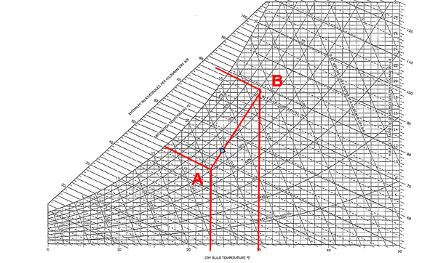
Using the Psychrometric Chart
Determine the entering air condition
If outdoor air (B) is mixed with recirculated air (A), how to determine the mixed air condition?
First step, need to determine the ratio of mixtures.
e.g. Fresh air 1000CMH, and recirculated air 3000CMH.
FA = 1000 / (1000+3000) = 25%, RA = 75%
Second step, determine the dry bulb temperature.
30 °C x 0.25 = 7.5 °C sum up = 24.75 °C
23 °C x 0.75 = 17.25 °C
This point will falls on the line of AB, so from the psychrometric
chart you can get all other properties.

Slide 12
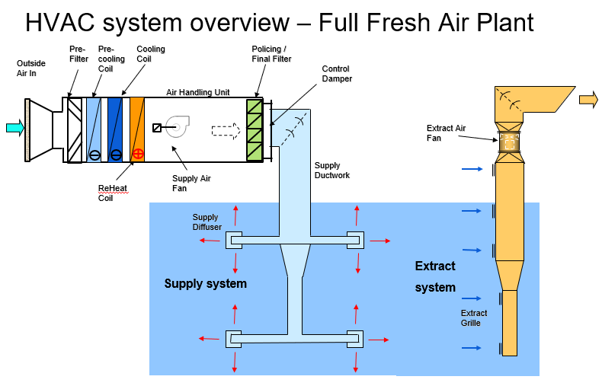
ACMV Fundamentals – HVAC overview

Slide 13
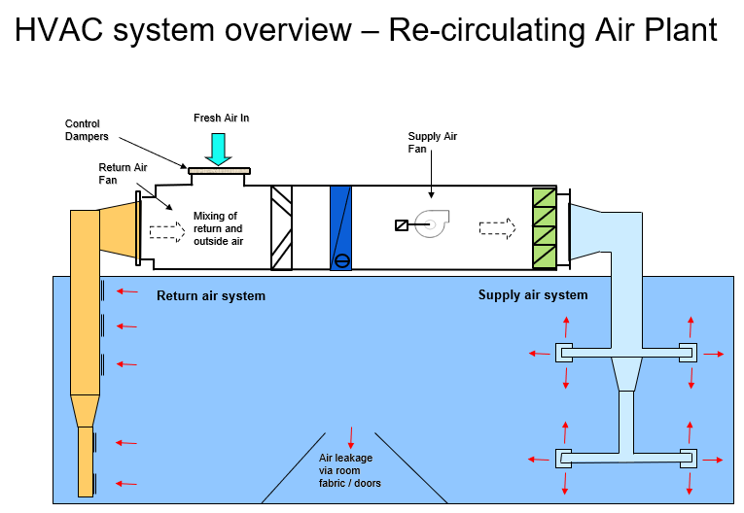
ACMV Fundamentals – HVAC overview

Slide 14
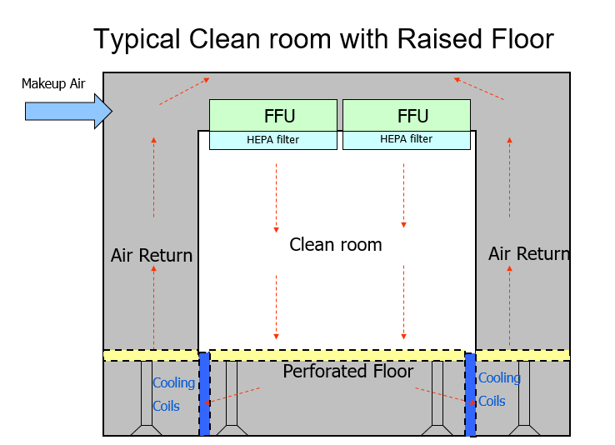
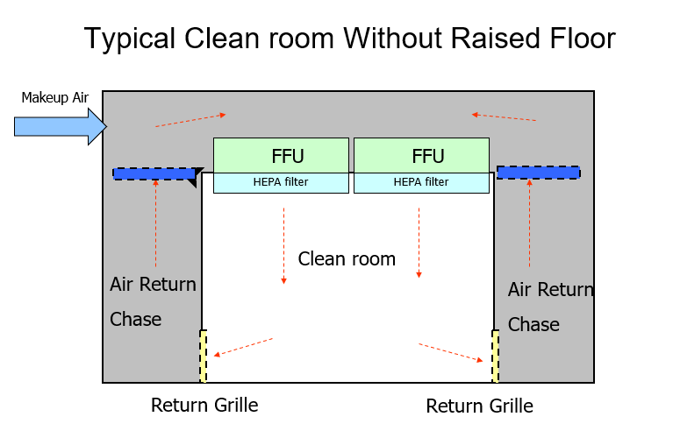
Cleanroom ACMV design

Slide 15
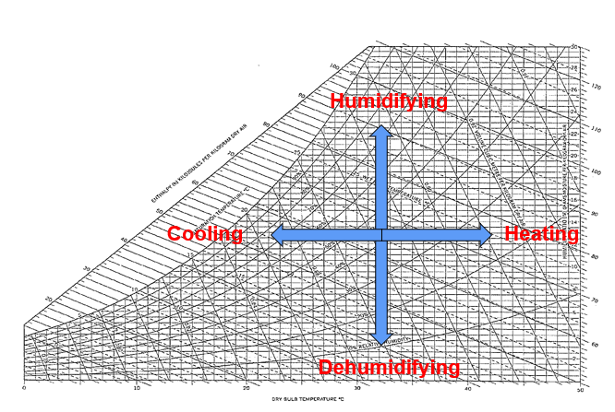
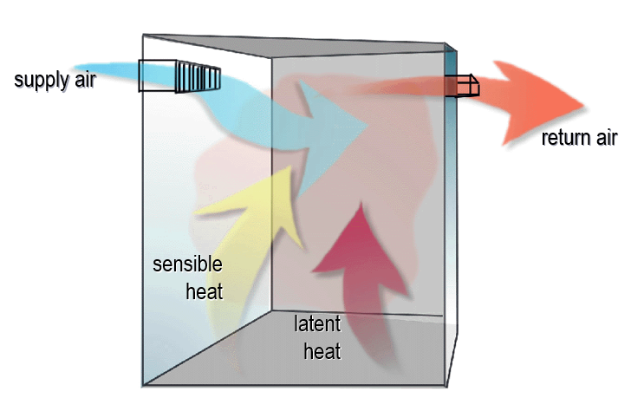
Sensible heat and Latent heat
The process of comfort heating and air conditioning is simply a transfer of energy from one substance to another. This energy can be classified as either sensible or latent heat energy.
Sensible heat is heat energy that, when added to or removed from a substance, results in a measurable change in dry-bulb temperature.
Changes in the latent heat content of a substance are associated with the addition or removal of moisture.

Slide 16
Air-conditioning Space design
Step 1
Calculate the heat load in the space
Step 2
Determine the space air-condition requirement
Step 3
Identify the supply air conditions
Step 4
Determine the supply air flow

Slide 17
Step 1 – Calculate the heat load in the space
Estimating of heat load involves a lot of factors,
Building orientation
Use of the space in the building
Physical dimensions of the space
Dimensions of columns and beams within the space
Construction materials
Surrounding conditions – presence of reflective surfaces, other buildings’ shading
Window sizes and position
Doors
Presence of stairways, lifts and escalators
Number and activity level of occupants
Lighting and types
Equipment, machines and appliances
Ventilation
Operation cycle of building

Slide 18
Step 2 – Determine the space air-condition requirement
Comfort zone as mentioned earlier
User requirement
Energy efficient consideration
Example:
Dry bulb temperature – 23 °C
Relative Humidity - 60%
Step 3 – Identify the supply air conditions
Coil curve
Sensible Heat Ratio
Apparatus Dew point Temperature
Simplified method (but no accurate):
On the psychrometric chart draw a cooling line from the space required point, the cross point with saturated line is the supply air condition.
For the given example, the supply air dry bulb temperature is around 14.6 °C, considering the accuracy and errors, to take the temperature as 14 °C.

Slide 19
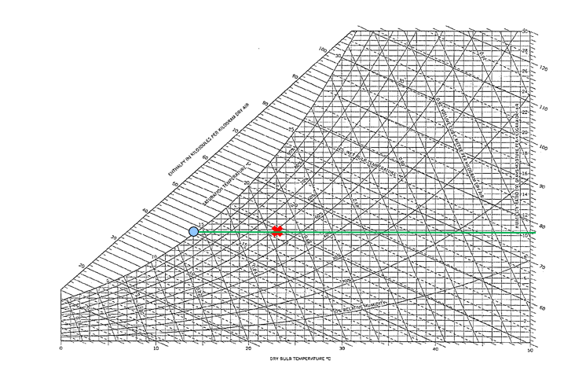
Step 3 – Identify the supply air conditions

Slide 20
Step 4 – Determine the supply air flow
If the heat load estimated is around 10kw for the given space,
Air flow rate = (0.83 x 10kw) / (23 – 14) =0.92 (m3/s) = 0.92x3600 = 3320 (m3/h)

