Slide 1
Specialty Gas Fundamentals
Basic Facilities Knowledge Package
Author: Wong Chee Keat
Yr.2019

Slide 2
Content Page
Gas Cylinder Introduction
Type of gas
Gas classification
Gas distribution
Gas distribution system/equipment
Gas distribution methods
Gas Equipment/System Safety Features
Gas purging
Auxiliary Equipment

Slide 3
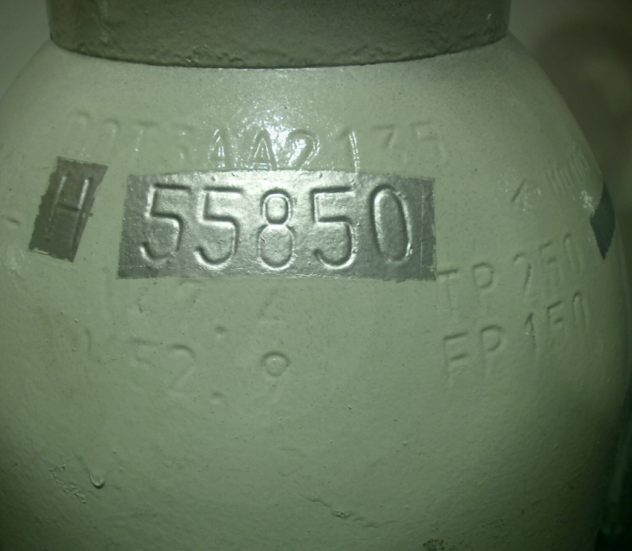
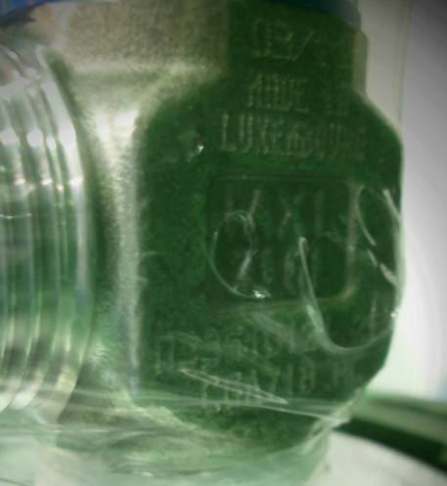
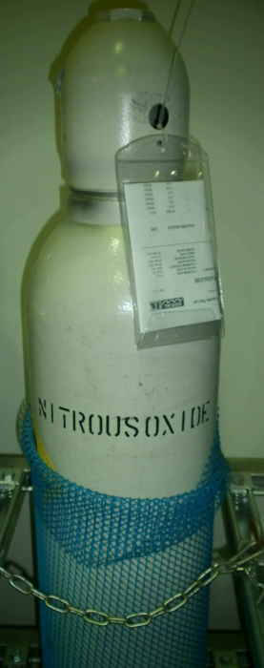
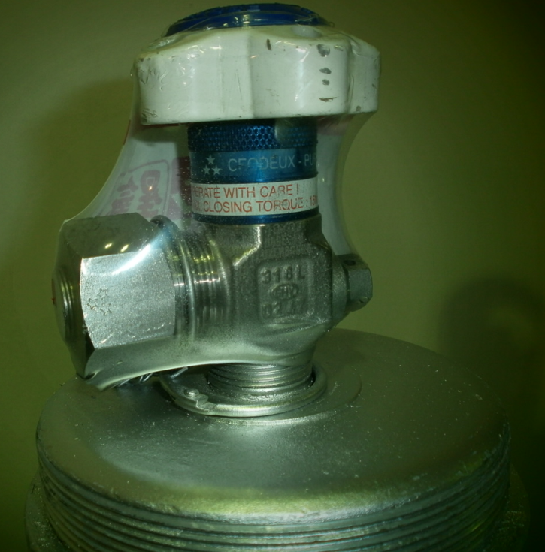
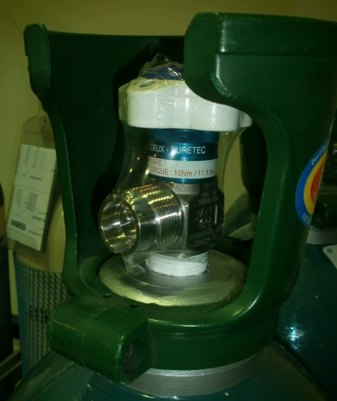
Gas Cylinder Introduction
Cylinder No
COA
(certificate of Analysis)
Cylinder Cap
Cylinder weight (Kg)
Valve outlet indication (CGA 718)
Gas name
Dust Cap
Manual valve
Cylinder Body
Valve body
Cylinder neck
Cylinder Valve outlet

Slide 4
Gas Type
Compressed gas
Always presence in gas form above its critical point.
Typically having pressure above 700psig
Gas are homogenous with impurities
Liquefied gas (low pressure or medium pressure)
Presence in 2 phases liquid and gas. Appear in liquid form when compress or cool to its critical point.
Low pressure -12psig to 15psig (SiCl4 -12psig, BCL3 4.4 psig)
Medium pressure 15psig to 600psig (HBr 320psig)
Pressure remain constant when liquid is present but pressure will drop when the temperature of cylinder drops or if flow is above the cylinder sustainable pressure.
Impurities in liquid phases increases when the heel is less than 10%
Vapor pressure P_{o}
Compress gas
Liquefied gas

Slide 5
Gas Classification
Gases can be:
Flammable (E.g. C4F8, )
Corrosive/ Toxic (E.g. Cl2, NH3)
Highly Toxic (E.g. B2H6)
Inert (E.g. N2O, CF4, CHF3, CO2)
Pyrophoric (E.g. SiH4)
Oxidizer (e.g. O2; N2O)
HAZARDS
Flammable: Chemicals that may catch fire in contact with air, only need brief contact with an ignition source, have a very low flash point or evolve highly flammable gases in contact with water.
Corrosive: May destroy living tissue / organ when on contact or inhale.
Toxic : Chemicals at low levels cause damage to health.
Highly Toxic: Chemicals that at very low levels cause damage to health or death.
Inert : Asphyxiation (lack of Oxygen), fatal when O₂ <18%
Pyrophoric : No ignition source required, will burn when release
Combination of both: Corrosive and Toxic ; Corrosive and flammable etc.8
Oxidizer : Substance that support combustion readily.

Slide 6
Gas Distribution Equipment/System
Gas Distribution Equipment
Gas cabinet
A gas distribution system that comes with an exhausted enclosure that normally houses toxic or flammable gas that requires special attention when working on it.
Gas panel
A gas distribution system that does not come with an exhausted enclosure and normally houses inert gas. Though not hazardous, special attention is still required when working on it.
POU
Point of use distribution
VMB Valve Manifold Box
A gas distribution system that comes with an enclosure that normally houses toxic or flammable gas that requires special attention when working on it.
VMP Valve Manifold Panel
A gas distribution system that does not come with an exhausted enclosure and normally houses inert gas. Though not hazardous, special attention is still required when working on it.

Slide 7
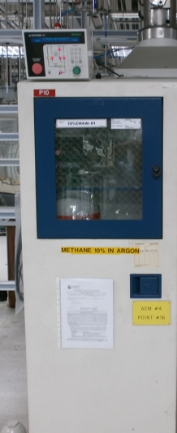
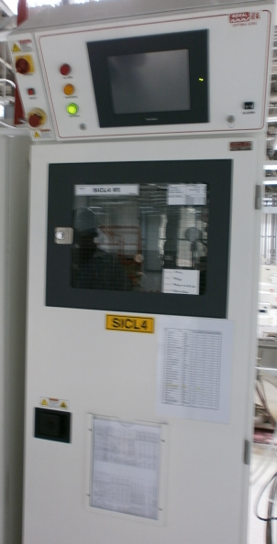
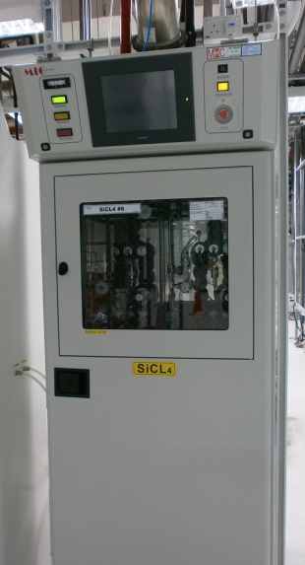
Gas Distribution Equipment/System
Gas Distribution Equipment
Gas cabinet
PRAXAIR UltraPurge 100
Microprocessor controller
Auto purge
5 Valve manifold
Exhausted
SOXAL Optima G300
PLC controller
Auto Purge
5 valve manifold
Exhausted
Marketech MIC MK6000
PLC controller
Auto purge
5 valve manifold
Exhausted
Praxair GC
SOXAL GC
Marketech GC

Slide 8
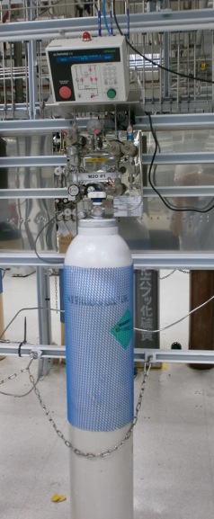
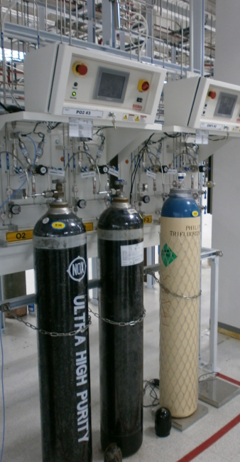
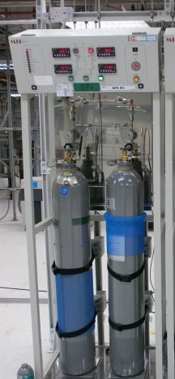
Gas Distribution Equipment/System
Gas Distribution Equipment
Gas Panel
PRAXAIR UltraPurge 100
Microprocessor controller
Auto purge
5 Valve manifold
Not exhausted
SOXAL Optima S200
PLC controller
Manual Purge
4 valve manifold
Not exhausted
Marketech MIC MK6000
PLC controller
Manual purge
5 valve manifold
Not exhausted
Praxair GP
SOXAL GP
Marketech GP

Slide 9
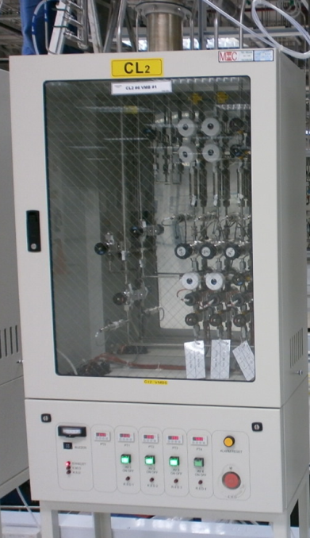
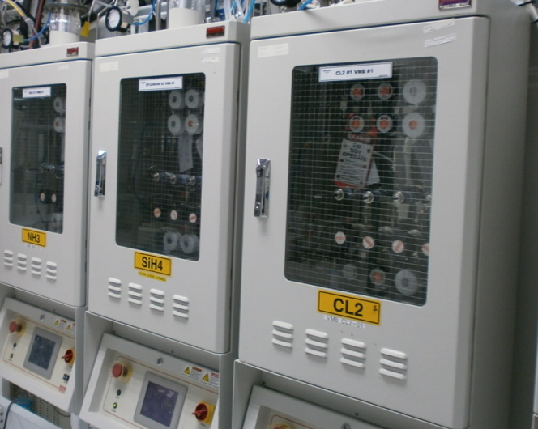
Gas Distribution Equipment/System
Gas Distribution Equipment
Valve manifold Box (VMB)
SOXAL Optima V200
PLC controller, touch screen
Semi Auto
VMB comes in 4 or 8 sticks
Exhausted
Marketech MIC MK6000
Relay type controller, span panel display
Semi Auto
VMB comes in 4 or 8 sticks
Exhausted
SOXAL Optimal V200 VMB
MIC MK6000 VMB

Slide 10
Gas Distribution Methods
POU distribution (point of use distribution)
Sub main approach
Advantage
Small footprint
Cost efficient
Can hook up to tools very fast
Disadvantage
Unable to do purging locally
Hard to access when piping management is not observed
No containment of gas leak
Free access to gas stick
Main uses for bulk gases such as Nitrogen and CDA
Tools
Tools
Tools
Gas cabinet/ Gas panel
Source

Slide 11
Gas Distribution Methods
VMB/VMP distribution
Advantage
Able to perform purging locally.
Easy access to gas stick.
Life Safety monitoring (gas leak contained within the exhausted environment)
Able to perform gas stick troubleshooting
Limited access to the gas stick
Disadvantage
Costly
Large footprint
Tools
Tools
VMB/VMP
Gas cabinet/ Gas panel
Source

Slide 12
Gas Equipment/System Safety Features
Excess flow switch (GC only)
Mainly used in highly toxic/toxic/pyrophoric gases
Position either before or after the regulator
Shut down gas system when triggered
Trigger due to an excess flow in the event of broken gas pipe
Loose VCR connection
Machine high flow etc
Double containment piping (GC and VMB)
Pressurize outer containment
Vacuum outer containment
Shutdown gas cabinet or individual gas stick when triggered
Triggered due to either inner or outer containment leak etc

Slide 13
Gas Equipment/System Safety Features
Vertex life safety system (GC and VMB)
Shut down gas cabinet when there is a level 2 leak detected at the monitoring point.
Sample flow will be exposed to the chemcassette tape and will be check by an detector optical head.
A gas detected will see SPOTs on the chemcassette.
Different gas type uses different chemcassette.
Turbulence flow; Air change/min
All Gas cabinet will have a louver. This will allow air change in the gas cabinet through the exhaust system.
The turbulence air movement in the cabinet will prevent build up of pocket of toxic gas in the gas cabinet.
All Highly toxic and flammable gas is recommended to have an air change of 12 AC/Min.
Exhaust
All toxic/flammable gas will have an exhaust.
Exhaust used will be based on gas type.

Slide 14
Gas Equipment/System Safety Features
Z-purge (GC and VMB)
Z-purge is a continuous flow of PN2 into the Electrical/Controller compartment.
This is to provide a positive pressure in the controller to prevent toxic/flammable gas in the compartment which may have potential fire hazard or health impact to the operators.
The secondary use of the Z-purge is to cool the electrical components such as solenoid valve.
Fire Sprinkle (GC)
PU pneumatic tubing (GC and VMB)
Pneumatic tubing to the valves are PU material.
In the event of fire will burn the PU tubing and hence cut off the air supply.
Auto purge (GC)
Gas cabinet have auto purge sequence. The auto purge sequence will provide check to ensure there is no abnormalities with the system.
The purge sequence will perform test like vacuum test, pressure test before and after cylinder change.
Purge sequence will not pass through and will give a local alarm when any of the test fail.

Slide 15
Gas purging
There are 3 types of purging prior to working on gas system such as cylinder change, gas line unhooking etc. The 3 purging types are
Flow through purge
Vacuum purge
Cycle purge
Flow through purge
Continuous flow of 5%He/N2 or PN2 through the machine chamber for a period of duration at min purge pressure of 30psig.
Advantage
Save on manpower and time
Disadvantage
Long purging time depending on gas type
High consumption of purge gas
Dangerous if no one monitor on the purging status

Slide 16
Gas purging
2) Vacuum purge
Continuous pulling of vacuum for a period of time either using the machine vacuum pump or using the vacuum generator at the VMB.
Advantage
Save on manpower and time
Disadvantage
The least effective way of purging
Gas bond to the pittings in gas line may not be desorbed by the vacuum
Use high volume of N2 for the vacuum generator if pulling from VMB
Dangerous if no one monitor on the purging status
3) Cycle purge
A series of pressurizing with purge gas and pulling of vacuum for a stated number of cycle base on gas type.
The pressurizing and pulling of vacuum works like a scrubbing effect.
Advantage
Most effective form of purging
Disadvantage
Time consuming
Man power taxing
Dangerous if not carry out properly

Slide 17
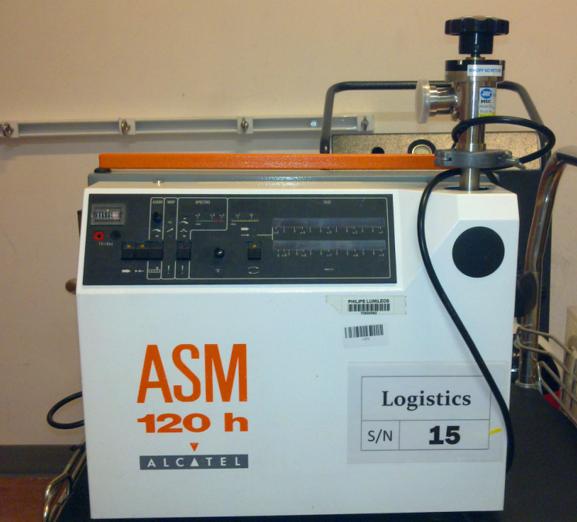
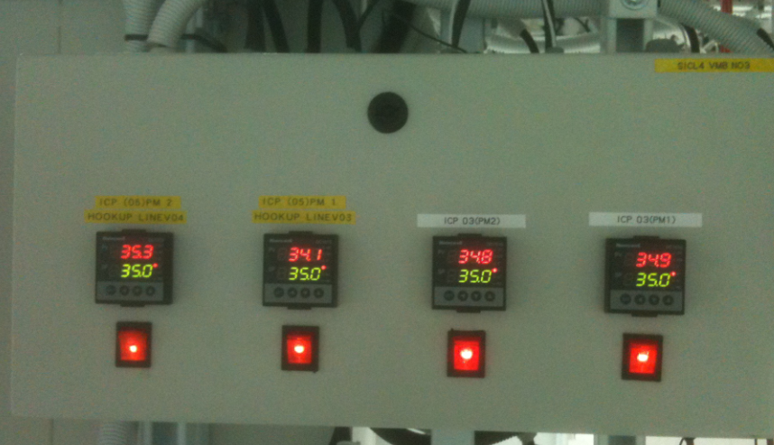
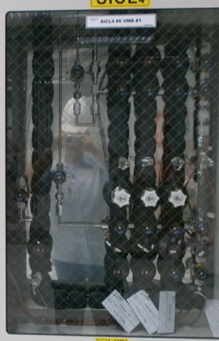
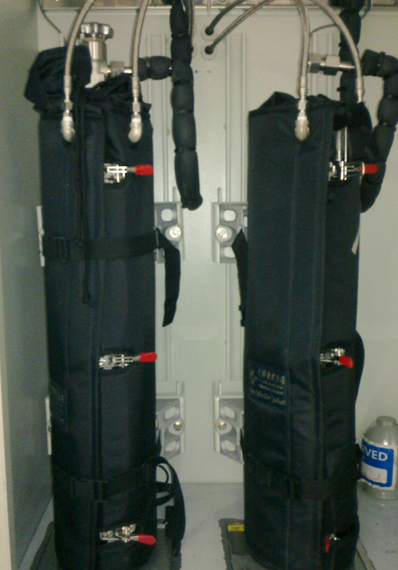
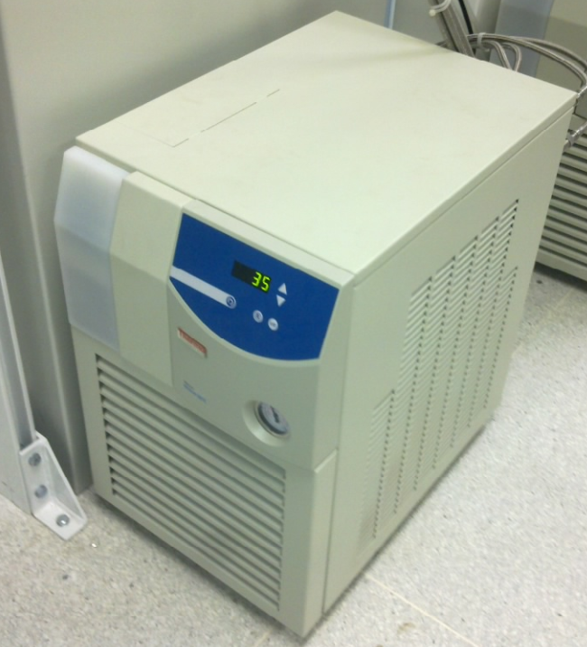
Auxiliary Equipment
Heat trace
Chiller
Chiller jacket
Alcatel helium leak detector
Heat Trace controller
Alcatel Helium Leak detector
Heat Trace
Chiller
Chiller Jacket

Slide 18
Auxiliary Equipment - Explained
Heat trace
A high resistance cable hence producing heat. Heat trace are used on the following condition
Liquefied gas (low vapor pressure)
Gas sensitive to pressure fluctuation
Gas having risk of condensation due to temperature difference in the gas line or high flow rate.
Chiller
Chiller are use to maintain the temperature of the cylinder. Coolant at 35deg.C is circulating the
cylinder through the jacket to provide;
Source of energy to vaporise the liquid
When usage is high the latent heat of vaporization will drop (gas temp drop) = drop in vapor
pressure. So chiller at 35deg.C will provide the energy for vaporization and hence maintaining the
gas vapor pressure.
Chiller jacket
Chiller jacket is used to wrap around the cylinder. It is a plate type where the heat is transferred by
conduction to the cylinder. Coolant from the chiller is pass through a tubing into the jacket.

Slide 19
Auxiliary Equipment - Explained
Alcatel Helium Leak detector
Helium leak detector can be used for Inboard and outboard helium leak check.
Inboard helium leak check
Equipment to be tested for leak will be hooked up to the leak detector. Alcatel will pump down the equipment chamber; gas line etc to 1*10-9 atm cc/sec.
Helium will be spray outside the equipment and on any connection.
When a leak is presence the Alcatel will not be able to maintain at 1*10-9 atm cc/sec and will sound off.
Inboard helium leak check normally carried out at tools or for new gas line welding joint.
Outboard helium leak check
Equipment to be tested for leak will be pressurized with He or 5%He/N2.
A sniffer probe attached to the Alcatel will used to sniff at the equipment or connection for Helium leakage.
When a leak is presence the Alcatel will not be able to maintain at 1*10-5 atm cc/sec and will sound off.
Outboard helium leak check is normally use to detect suspected leak at VCR connections, after cylinder change (for non inert only) to check for the connection between pigtail and cylinder valve outlet etc.

